Slide 1
OIIE/OGI Pilot Phase 3 Pilot Overview
September 24, 2018

Slide 2
OIIE Coordination Points with CII
What is the Open Industrial Interoperability Ecosystem (OIIE)?
A supplier-neutral industrial digital ecosystem specification for process industries and their suppliers
Primary OIIE Objectives (Industry Digitalization and Interoperability)
Provide a pragmatic, provable basis for process industry digital transformation by 2020
Connects O/Os, EPCs and OEMs as well as other industry suppliers
OIIE Methods
Industry Use Case Driven- Reflecting prioritized functional and non-functional requirements
Incrementally Defined and Improved using multiple existing standards used together in a repeatable, scalable way
Consistent IT/IM Architecture for Intra and Inter-Enterprise Activities
Build and Maintain the supplier neutral specifications for a Digital Twin meeting identified industry requirements
Use Digital Twin as contextualization for IIOT, Big Data and Analytics
OIIE OGI Pilot- R&D Probing grounds for OIIE and ISO 18101
Request for CII - Alignment between key MIMOSA and CII Workstreams and Organizations
CII Advanced Work Packaging-OIIE/MIMOSA Solutions Packages and Standard Systems Packages for Oil and Gas
Process industry Practices and MIMOSA
CII/Fiatech Interoperability Charter

Slide 3
Full Asset Life-cycle Management
Completion,
Commission and Startup
Continuous Improvement Feedback Loops
Product
Design
Product
MFG
Process
Engineer
Simulate
Engineer
Design
Procure
Construct
Operate & Maintain (O&M)
End of Life
Device/Equip
Manufacturing
Platform Integrator
Capital Project
Owner/Operators
Product Model/Product=Component/Systems(Packages)/System of Systems/Plant/Facility/Platform Life-Cycles
Derived from ISO TC 184
Manufacturing Asset Management Integration Task Force Final Report

Slide 4
Standard OIIE/OGI Use Cases
Cross Project Activities
Capital Projects
Complete/ Commission/ Startup
Operate/ Maintain
Decommission/ Dispose
Opportunistic Handover of Structured Digital Assets
Sustained Life-cycle Digital Asset Management
OIIE Use Case 1: Information handovers to O&M
OIIE Use Case 2: Recurring Engineering Updates to O & M
OIIE Use Case 3: Field Changes to Plant/Facility engineering
OIIE Use Case 4: Enterprise Product Data Library management (tied to ISDDs)
OIIE Use Case 5: Asset Installation/Removal Updates
OIIE Use Case 6: Preventive Maintenance Triggering
OIIE Use Case 7: Condition Based Maintenance Triggering
Yellow Use Cases in Phase 3 – Sub-Phase 1
OIIE Use Case 8: Early Warning Notifications
OIIE Use Case 9: Incident Management/Accountability
OIIE Use Case 10: Automated Provisioning of O & M systems
OIIE Use Case 11: Enterprise RDL Management
OIIE Use Case 12: RFI and RFI Response (Models Meeting Requirements and Model Information, Green and Brown Field)
OIIE Use Case 13: Lockout/Tagout

Slide 5
Supplier Neutral Industrial Digital Ecosystem Digital Ecosystem Concept Specialized For Process Industries
Enterprise Ecosystem Nodes
Com-ponents
Systems
Network of Enterprise Ecosystems
EPC
Ecosystem
Owner
Operator
Ecosystem
Interoperating Enterprise Digital Ecosystems
Supplier Neutral
Industrial Digital Ecosystem
OEM
Ecosystem
Systems
Com-ponents

Slide 6
EPC Firms
OIIE Inter-Enterprise Systems Connectivity and Services Architecture
Engineering , Procurement and Construction
IT Networks
Functional and Technical Requirements
Business Requirements
OEMs
Manufacturers
PFD, P&ID, Tags, Docs
& Requirements
Owner/Operators
Model and Instance Information
Enterprise Business Systems
Enterprise Business Systems
IT Networks
IT Networks
Manufactured Asset Data
(Make/Model Information, Serial #)
Operations & Maintenance Data
(Monitoring, Diagnostics Prognostics)
Automation and Control
Automation and Control
Notes:
7ohnyMy liukmhmmmm

Slide 7
OIIE Intra-Enterprise Systems Connectivity and Services Architecture
Enterprise Business Systems
OIIE Administration
Planning
Engineering Design
Construction Management
Operations Management
Operations Risk Management
Maintenance Management
IEC 62264 Messaging Service Model /OpenO&M Information Service Bus Model
Standard, Cloud Friendly Enterprise Solutions Architecture For Digital Business Ecosystems
Trusted
Systems
Inter-Enterprise Connections
Automation and Control
HSE and Operation Monitoring
Prognostic & Health Management
Connectivity Legend
Automation Control Bus
IIoT Connections
IIOT Device
(Constrained)
Device
Device
Sensor/ Transducer
Trusted IT/OT connections
ISBM Web Services
(Constrained)
Shared Information and Semantic Context
Enterprise Reference Data Libraries
IIoT Device Metadata
Industry Reference Data Libraries
IIoT Device Metadata
(ISO 15926, OTD, CDD…)

Slide 8
OIIE OGI Pilot Next Phase (s)
Objective- Drive Industry Digital Business Transformation
Reach agreed “industry digitalization inflection point” by 2020
Aligned with CII/Fiatech, IOGP and NIST Priorities
3 Sub-phases – 5 months each
1st sub-phase– Validate ISDD Process, Add 50+ISDDs, Core OIIE Use Cases covering asset life-cycle
Sub-phases 2 and 3 add AWP, 2 JIP 33 Packages, More OIIE Use Cases, ISDDs and suppliers, add target unit(s)
Sub-Phase 1 - 5 Priority Use Cases covering key parts of life-cycle, using ISDDs for properties
RFI/RFI Response (Greenfield) – Main source of information for Model Selection
Install Assets on Functional Locations (Greenfield Capital Project)
CBM Information Capture and Triggering (2 Device Classes with ISDDs, Instrument and Drive/Motor)
Remove and Replace Use Case
RFI/RFI Response (Brownfield) – Core for Information Remediation
Build 50+ ISDDs (ISA Rev 1 Sheets plus 5 others), Validate overall ISDD Process through use cases included
Use Existing Debutanizer Tower Engineering Dataset (Originally provided by Worley Parsons) and Add To It
Focus on Condenser Unit which includes the instrument and equipment classes with existing ISDDs

Slide 9
OIIE Standardized Use Case Architecture Standardized Methodology to Define and Re-use OIIE Components
Use Cases
Scenarios
Events
Background
Actors
Individual Message Exchange
Scope
Preconditions
Successful End Condition
Data Content
Data Formats
Reference Data
(OIIE) Events
Information Service Bus Configuration
Specific Data Content (Information/Data Model?)
CCOM BODS are an implementation of Events
Required data processing
Expected Response Event (if any)
Actors
Triggers
Process Workflows
Scenarios
User Stories
High-level
Pictographic
Depict 1 or more Use Cases, Scenarios, and/or Events
Actors, Systems, Exchanges, Data
User Stories

Slide 10
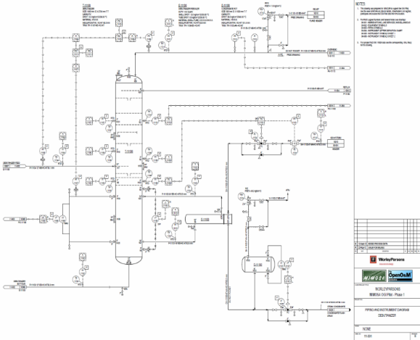
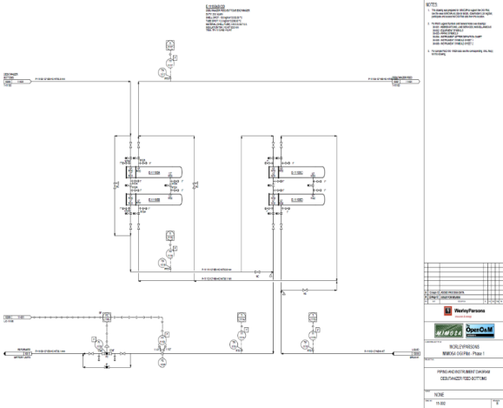
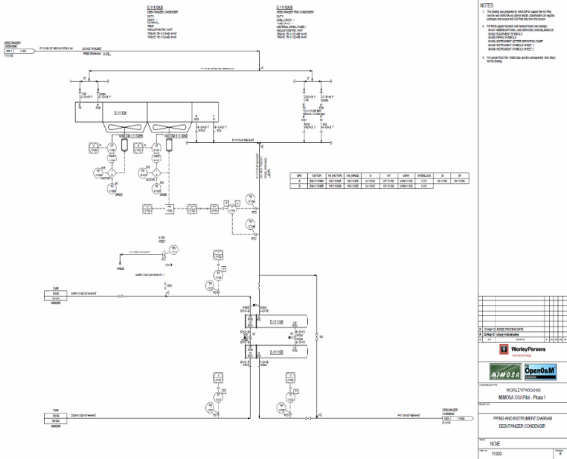
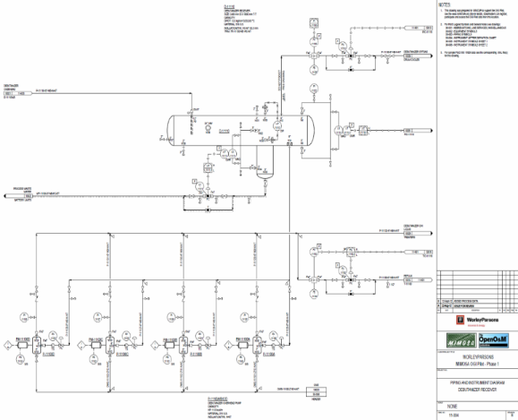
Debutanizer Tower P&IDs – Worley Parsons

Slide 11
Business Driven ISDD Build and Use Plan for 2018/2019
75 ISA Rev 1 Sheets
Pilot Sub-Phase 1
A
5
Other
I
S
D
D
S
B
25 ISA Rev 1 Sheets
Pilot Sub-Phase 2
C
15
Other
I
S
D
D
S
D
+ISDDs based on CFIHOS Classes
Numbers of Properties on ISDs
All properties needed for digitalization
ISA- 150-350
API- 100-900*
Business-Driven Work Arounds
CFIHOS
Limited number of properties (30-50) based on current industry use practices
ISA Rev 1 Sheets can now be converted to ISDDs through mostly automatic processing.
Will work with members and industry to prioritize Sets B and D and work around strategy for all remaining classes.

Slide 12
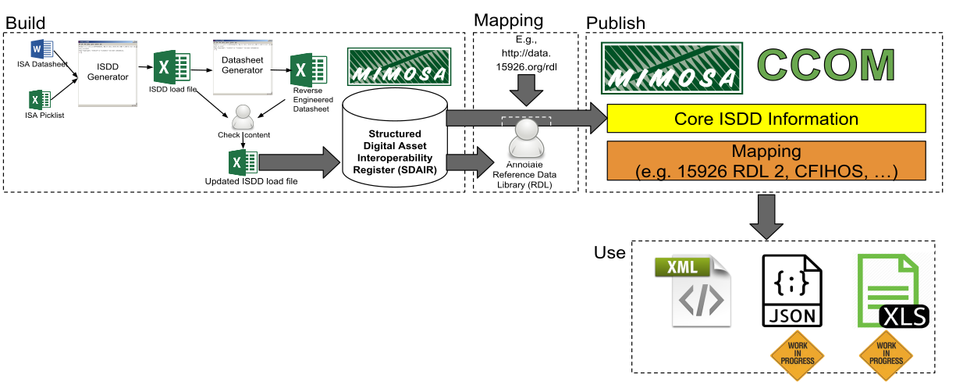
Current ISDD Build Process
Applies to ISDs from all sources (ISA, API, IEC, etc.)
Degree of automation differs based on the complexity/consistency of the datasheet
Manual QA review identifies issues with extracted properties and issues/ambiguities in source datasheets
XML–primary format for ISDDs
JSON–for IoT, light-weight data exchange (instance data sets & events)
Excel Spreadsheet–for Human Readability

Slide 13
Backup Slides

Slide 14
Critical Infrastructure Sectors – From PDP 21-2013
Chemical Sector-Specific Agency: Department of Homeland Security
Commercial Facilities Sector-Specific Agency: Department of Homeland Security
Communications Sector-Specific Agency: Department of Homeland Security
Critical Manufacturing Sector-Specific Agency: Department of Homeland Security
Dams Sector-Specific Agency: Department of Homeland Security
Defense Industrial Base Sector-Specific Agency: Department of Defense
Emergency Services Sector-Specific Agency: Department of Homeland Security
Energy Sector-Specific Agency: Department of Energy
Financial Services Sector-Specific Agency: Department of the Treasury
Food and Agriculture Co-Sector-Specific Agencies: U.S. Department of Agriculture and Department of Health and Human Services
Government Facilities Co-Sector-Specific Agencies: Department of Homeland Security and General Services Administration
Healthcare and Public Health Sector-Specific Agency: Department of Health and Human Services
Information Technology Sector-Specific Agency: Department of Homeland Security
Nuclear Reactors, Materials, and Waste Sector-Specific Agency: Department of Homeland Security
Transportation Systems Co-Sector-Specific Agencies: Department of Homeland Security and Department of Transportation
Water and Wastewater Systems Sector-Specific Agency: Environmental Protection Agency

Slide 15
Industry Standard Data Sheets (ISDs)
Currently have identified 263 source ISDs in common use
Most commonly identified ISD publishers are listed below
Current recognized metrics and processes will change as industry digitalizes
API | 15 (+20 ISO equivalents)
ASME | 2 (+1 ISO equivalent)
IEC | 10
ISA | 166
ISO | 28
NORSOK | 31
P I P | 11

Slide 16
Dow List
DATASHEET TYPE (All Versions)
Dow Pressure Safety Valve
Dow Pressure Vessel
Dow Centrifugal Pump Non-API (aka ANSI)
Dow Shell And Tube Heat Exchanger
Dow Filter Cartridge Or Basket
Dow Piping - Hose and Coupling
Dow Air Driven Diaphragm Pump
Dow Centrifugal Pump Sealless
Dow Storage Tank
Dow Pressure Vacuum Relief Vent
Dow Steam Trap

Slide 17
Contextualization for Open Industrial Interoperability Ecosystem using MIMOSA CCOM 4.x, ISA, OAGi, ISO and IEC Standards
Process Engineering-(CCOM Segment Networks)- PFDs
Work Processes followed for CAPEX and OPEX (Intra and Inter-Enterprise)
Production Process to be supported by Plant/Platform/Facility
Functional/Systems Engineering-(CCOM Segment Networks)- P&IDs , other schema
System of Systems
Systems (Functional Packages)
Functional Locations (P&ID Tag)
Components
Sensors
Models - (CCOM Model) – Used for MFG Model and Package Model
Serialized Equipment & Devices-(CCOM Assets installed in CCOM Functional Locations)
Multiple Breakdown Structures as Needed- Taxonomic views of same CCOM objects
Enterprise Breakdown – Enterprise/Area/Unit (ISA 95/88)
Maintenance Breakdown Structure - (eg ISO 14224)
ISDDs - Property Sets for ALL Functional Locations, Equipment and Devices
IIOT- Data captured by Sensors is Contextualized by ALL of Above

