Slide 1
Using Asset Management Standards and the Open Industrial Interoperability Ecosystem (OIIE) to enable Critical Infrastructure Management on a Cross Sector Basis
— Alan T. Johnston, MIMOSA
— Markus Stumptner, UniSA and Co-CTO MIMOSA
@ Asset Institute
Standardization Workshop
November 8, 2018

Slide 2
Asset Management Standardization for Critical Infrastructure Management: Workshop Outline – Part A
Introduction: What is MIMOSA and Workshop Leaders
Understanding Critical Infrastructure: What is Critical Infrastructure?-Alan
  Critical Infrastructure Scope – From US PPD 21- 2013
  Interdependent and Heterogenous Nature of Critical Infrastructure
  Need for Public and Private Sector coordination with shared responsibilities for Risk Management
    Cooperation with US NIST and US DOE
    Public Sector includes Federal, State and Local Governments (National and Multi-Lateral)
    Private Sector includes all private owner/operators in sectors of critical infrastructure and their key suppliers
  Key Interrelated Problems
Proposed Solution
  Model, Monitor and Manage the Processes, Systems and Components
  Supplier-Neutral industrial Digital Ecosystem
  Open Industrial Interoperability Ecosystem (OIIE)
  OIIE Oil and Gas Interoperability (OGI) Pilot
  Greenfield versus Brownfield (and the need for infrastructure and information remediation)

Slide 3
Asset Management Standardization for Critical Infrastructure Management: Workshop Outline – Part B
Group Background and Ecosystem Projects
New Open Industrial Interoperability Ecosystem (OIIE) Use Cases-Markus
  Standard OIIE Use Case Architecture
  RFI/RFI Response for both Greenfield and Brownfield Asset Model Information
Industry Standard Datasheet Definition (ISDDs)- Major Developments- Markus
  ISDD Build Process
  ISDD Mapping
  ISDD Use and Re-Use
  Major Breakthrough in Instrumentation ISDDs – Top 100 Now Achievable by Q2 2019
Working with Land O’ Lakes, NIST and Open Applications Group (OAGi) –Markus
  Industrial Internet of Things (IIOT) and other Sensor Data
  New CBM Use Case
  Contextualization based on MIMOSA CCOM and the OIIE
  CCOM and Breakdown Structure

Slide 4
Asset Management Standardization for Critical Infrastructure Management: Workshop Outline – Part C
Initiation of the next phase of the OIIE/Oil and Gas Interoperability (OGI) Pilot – Alan
  Shared Piloting environment for OOs, EPCs and OEMs working with many software suppliers
  Next phase Includes 7 key OIIE Use Cases spanning CAPEX and OPEX (RFI through CBM)
  Engineering models developed by EPCs, as in a real project
  Validates all parts of OIIE, providing R&D Testbed for Digitalization and Interoperability
Collaboration with other Industry Associations, ISO and IEC - Alan
Q&A

Slide 5
MIMOSA Organizational Summary
MIMOSA is a 501 (c) 6 mutual benefit association formed in 1997 to develop supplier-neutral standards enabling complex industrial assets, systems and associated processes to be modeled, monitored and managed, wherever they may be operated.
  Early funding: Office of Naval Research for Dual Use Technology (Industry and Military/Aerospace)
  Focus on “Asset Intensive” industries (often process industries and their suppliers)
  Members include Owner/Operators, OEMs and major industrial Software Suppliers
MIMOSA identifies and/or develops fit for purpose IM and IT standards to enable good practices (defined by other groups) to be deployed in a supplier-neutral manner.
MIMOSA’s recent focus: Industry Digital Business Transformation
  Based on the Digital Ecosystem paradigm
  Open Industrial Interoperability Ecosystem (OIIE): A supplier neutral ecosystem specification
  Adaptable, Repeatable, Scalable & Sustainable: decreasing costs & risks across the asset life-cycle
  Oil and Gas Interoperability Pilot (OGI Pilot): OIIE instance with Oil and Gas asset classes
  Enabling cross-sector Critical Infrastructure Management

Slide 6
What is Critical Infrastructure
Critical infrastructure (or critical national infrastructure (CNI) in the UK) is a term used by governments to describe assets that are essential for the functioning of a society and economy – the infrastructure. – Wikipedia
Government led efforts have addressed key aspects of Security (physical and cyber) and Resilience (usually focused on disaster and emergency preparedness).
A key aspect of Critical Infrastructure is that it is Highly Interdependent.

Slide 7
Critical Infrastructure Sectors – From US PPD 21-2013
Chemical
Commercial facilities
Communications
Critical manufacturing
Dams
Defense industrial base
Emergency services
Energy
Financial services (including insurance)
Food and agriculture
Government facilities
Healthcare and public health
Information technology
Nuclear reactors, materials, and waste
Transportation systems
Water and wastewater systems

Slide 8


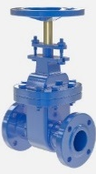
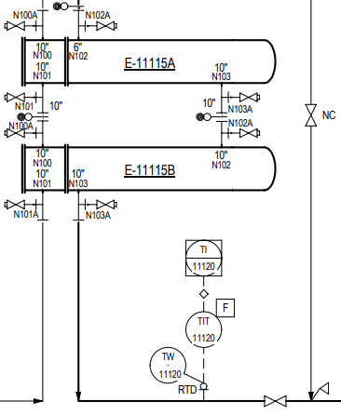
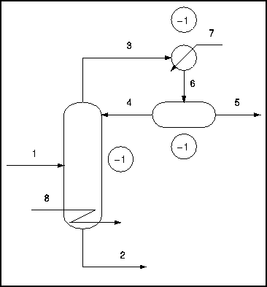

Critical Infrastructure Management
Critical Infrastructure Management Process
$
Trusted Systems
IIOT Sensors
Risk Models
Business Process Models
Components Models
Systems Models
Industrial Process Models

Slide 9
Critical Infrastructure Management Process
Public/Private Cross-Sector
Energy, Wastewater Management, Transport, IT
Enterprise 1 (Energy)
Plant 1
Plant 2
Enterprise 2 (Agriculture, Chemicals)
Facility 1
Multiple Sectors
Enterprises
Plant/Platform/Facility
Facility 2
Enterprise/Area/Unit
Risk Models
Risk Models
Risk Models
Risk Models
Business Process Models
Business Process Models
Business Process Models
Business Process Models
Components Models
Components Models
Components Models
Components Models
Systems Models
Systems Models
Systems Models
Systems Models
Industrial Process Models
Industrial Process Models
Industrial Process Models
Industrial Process Models

Slide 10
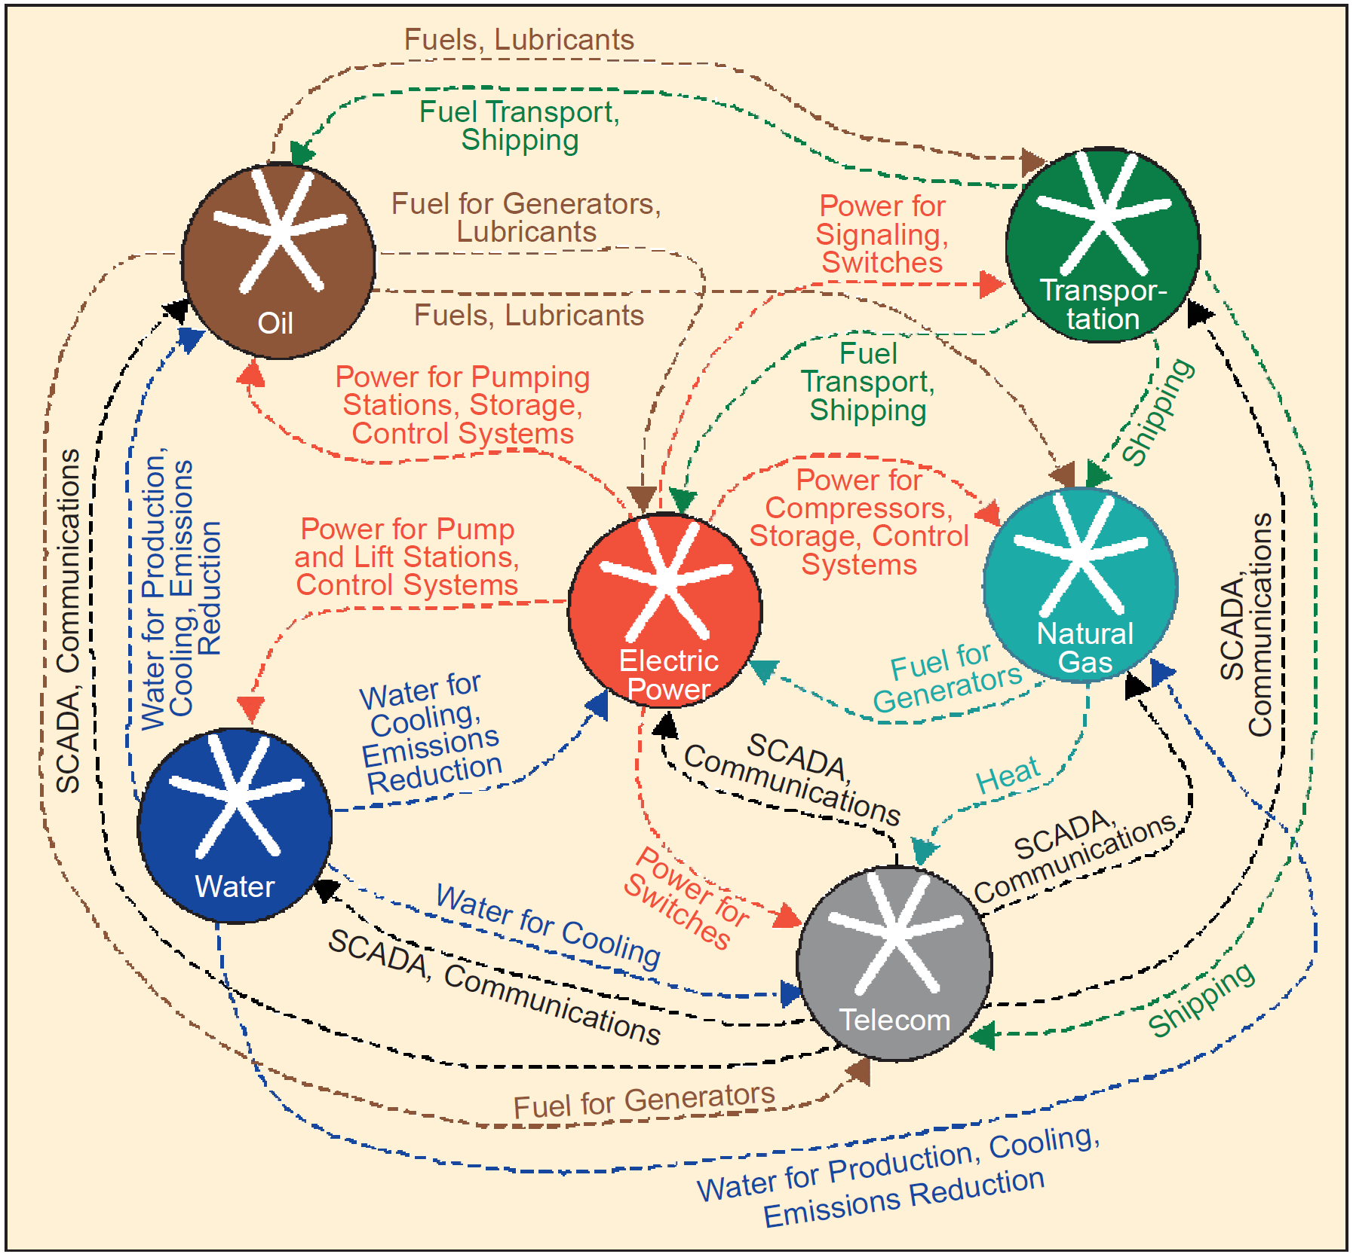
Critical Infrastructure Interdependencies-1
IEEE Journal- Dec 2001
Identifying, Understanding, and Analyzing
Critical Infrastructure Interdependencies
Steven M. Rinaldi
James P. Peerenboom
Terrence K. Kelly

Slide 11
Critical Infrastructure Interdependencies-1a
IEEE Journal- Dec 2001
Identifying, Understanding, and Analyzing
Critical Infrastructure Interdependencies
Steven M. Rinaldi
James P. Peerenboom
Terrence K. Kelly

Slide 12

Critical Infrastructure Interdependencies-2
NIST Special Publication 1190
Community Resilience Planning Guide
For Buildings and Infrastructure Systems
Volume II
October 2015

Slide 13

Critical Infrastructure Interdependencies-3
State Energy Resilience Framework
Global Security Sciences Division
December 2016
J. Philips, M. Finster, J. Pillon, F. Petit and J. Trail

Slide 14
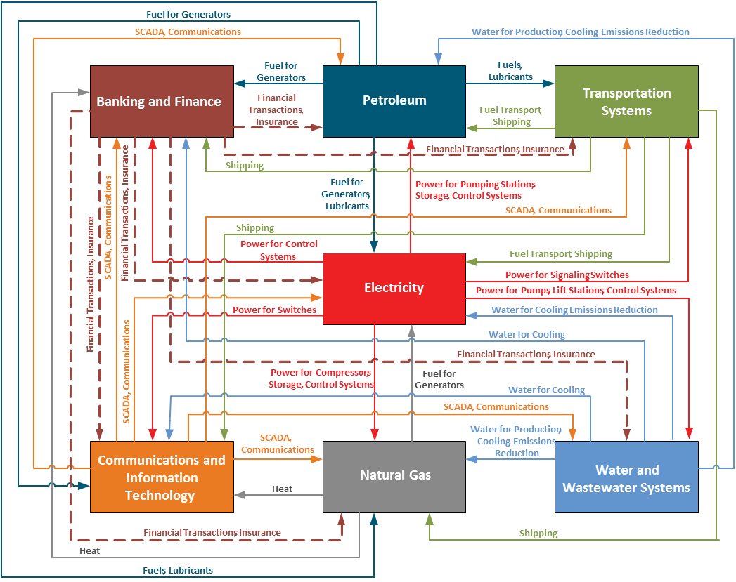


Critical Infrastructure Interdependencies-4
Incorporating Prioritization in Critical Infrastructure Security and Resilience Programs
Homeland Security Affairs 13, Article 7
(https://www.hsaj.org/articles/14091)
October 2017
Duane Verner, Frederic Petit, and Kibaek Kim

Slide 15
Critical Infrastructure Interdependencies-5
NSW Critical Infrastructure
Resilience Strategy
Partner, Prepare, Provide
NSW Department of Justice | Office of Emergency Management
2018

Slide 16

The Critical 5
The Critical Five was established in 2012 to enhance information sharing and work on issues of mutual interest between Australia, Canada, New Zealand, the United Kingdom and the United States.
One of the first efforts was to understand how each country addresses critical infrastructure as a basis for clearly articulating and communicating a common message on the value, meaning, and importance of critical infrastructure.
“Forging a Common Understanding of Critical Infrastructure” published March 2014.
“The Role of Critical Infrastructure in National Prosperity” published October 2015

Slide 17




Australia, Japan and United States Trilateral Partnership
Announced July 31, 2018
  Australia: Minister for Foreign Affairs-The Hon Julie Bishop MP
  Japan: Japanese Bank for International Cooperation
  United States: United States Overseas Private Investment Corporation (OPIC)
Indo-Pacific region
Cooperation on Investment to:
  Build infrastructure
  Address development challenges
  Increase connectivity
  Promote economic growth

Slide 18
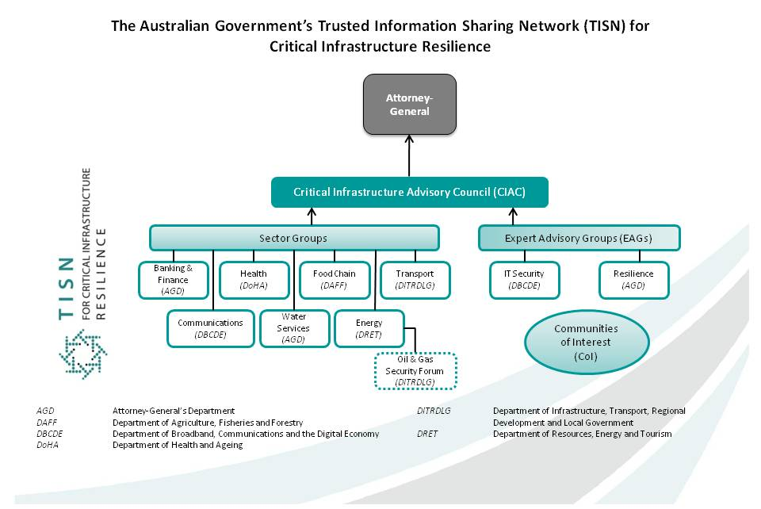

Slide 19
Interrelated Problems
Critical Infrastructure Management is inherently Cross-Sector and has mostly been focused on Security (physical and cyber) and Disaster Mitigation, while discussing Resilience
Due to the interdependent nature of Critical Infrastructure, the consequences of failure of the key sector activities may be broad reaching and catastrophic (no matter the cause of the failure).
Major capital projects are routinely experiencing 25-50 percent cost overruns
Current Process for life-cycle management of Asset Information is highly fragmented and inefficient
Methods for modeling, monitoring and managing Processes, Systems and Components (Assets) are fragmented, even within a single industry sector

Slide 20
The Proposed Solution
We propose a standardized approach to Model, Monitor and Manage the associated Processes, Systems, Components and Risks
Use Supplier-neutral Standards for Digitalization and Interoperability
Cooperation with Public and Private Sectors and Academia
Cooperation with NIST and DOE, results flow to ISO
When done as an integrated part of industrial life-cycle asset management
  Helps lower costs and risks in both CAPEX and OPEX
  Provides a basis for Cross-Sector Critical Infrastructure Management
  Provides the basis for a Supplier-Neutral industrial digital ecosystem specification
Open Industrial Interoperability Ecosystem (OIIE)-MIMOSA Branded, Supplier-Neutral
Oil and Gas Interoperability (OGI) Pilot
  Interoperability R&D Proving Grounds
  Gate Keeper for ISO 18101 (ISO OGI TS)

Slide 21
Level R4
Primary business process: Operations
Level R3
Secondary business process:
Establish and Maintain Operations Capability
P to B Stack:
Automation ERP
system
Level R2
Level R1
Level R0

Slide 22
Full Asset Life-cycle Management
Completion,
Commission and Startup
Continuous Improvement Feedback Loops
Product
Design
Product
MFG
Process
Engineer
Simulate
Engineer
Design
Procure
Construct
Operate & Maintain (O&M)
End of Life
Device/Equip
Manufacturing
Platform Integrator
Capital Project
Owner/Operators
Product Model/Product=Component/Systems(Packages)/System of Systems/Plant/Facility/Platform Life-Cycles
Derived from ISO TC 184
Manufacturing Asset Management Integration Task Force Final Report

Slide 23
Standard OIIE/OGI Use Cases
Cross Project Activities
Capital Projects
Complete/
Commission/
Startup
Operate/
Maintain
Decommission/
Dispose
Opportunistic Handover
of Structured Digital Assets
Sustained Life-cycle Digital Asset Management
OIIE Use Case 1: Information handovers to O&M
OIIE Use Case 2: Recurring Engineering Updates to O & M
OIIE Use Case 3: Field Changes to Plant/Facility engineering
OIIE Use Case 4: Enterprise Product Data Library management (tied to ISDDs)
OIIE Use Case 5: Asset Installation/Removal Updates
OIIE Use Case 6: Preventive Maintenance Triggering
OIIE Use Case 7: Condition Based Maintenance Triggering
Yellow Use Cases in Phase 3 – Sub-Phase 1
OIIE Use Case 8: Early Warning Notifications
OIIE Use Case 9: Incident Management/Accountability
OIIE Use Case 10: Automated Provisioning of O & M systems
OIIE Use Case 11: Enterprise RDL Management
OIIE Use Case 12: RFI and RFI Response (Models Meeting Requirements and Model Information, Green and Brown Field)
OIIE Use Case 13: Lockout/Tagout

Slide 24
Digital Ecosystem-Why?
Wikipedia: The concept of Digital Business Ecosystem was put forward in 2002 by a group of European researchers and practitioners, including Francesco Nachira, Paolo Dini and Andrea Nicolai, who applied the general notion of digital ecosystems to model the process of adoption and development of ICT-based products and services in competitive, highly fragmented markets like the European one.
More recently, the term has been shortened to Digital Ecosystem

Slide 25
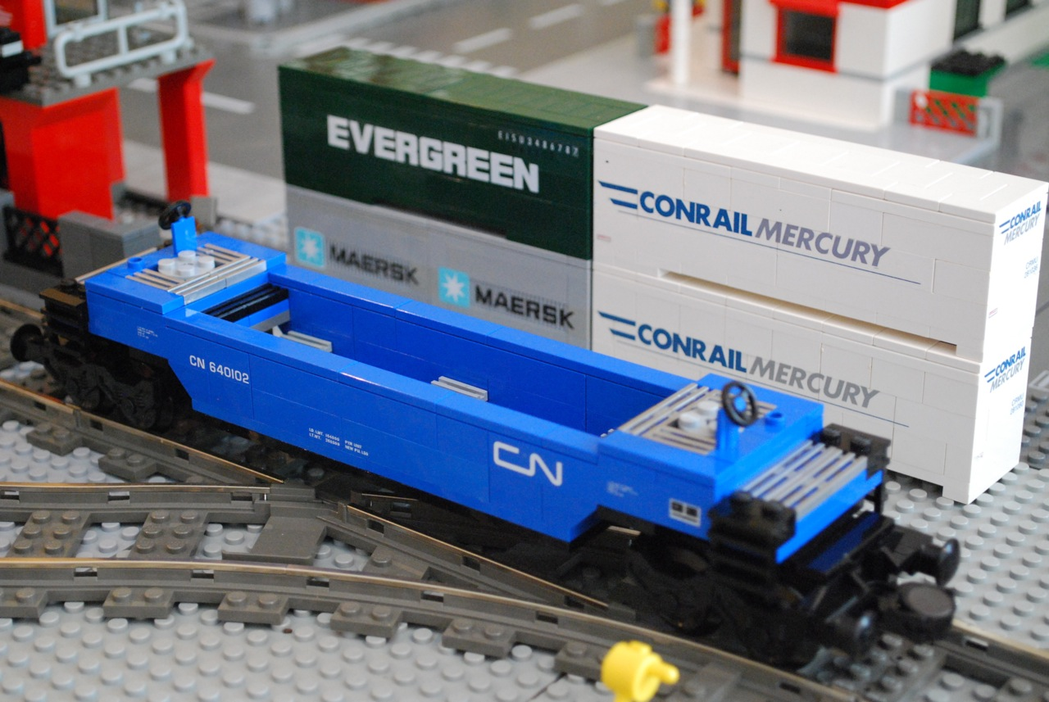
Ecosystems and Interoperability
Supplier-specific Interoperability
  Lego
  Enterprise Resource Planning (ERP)
  Apple Ecosystem
Open Source
  Linux
  Android
Standards-based Interoperability
  Intermodal Transport
  Internet
  Industrial Internet of Things (IIOT)
  Open Industrial Interoperability Ecosystem (OIIE) – Embraces COTS & Open Source

Slide 26
Supplier Neutral Industrial Digital Ecosystem
Digital Ecosystem Concept Specialized For Process Industries
Enterprise Ecosystem Nodes
Com-ponents
Systems
Network of Enterprise Ecosystems
EPC
Ecosystem
Owner
Operator
Ecosystem
Interoperating Enterprise Digital Ecosystems
Supplier Neutral
Industrial Digital Ecosystem
OEM
Ecosystem
Systems
Com-ponents
Major suppliers of IT Infrastructure and Industrial Applications and Systems all want their ecosystem to be THE Ecosystem.

Slide 27
OIIE Inter-Enterprise Systems Connectivity and Services Architecture
Enabling Industry 4.0
EPC Firms
Engineering , Procurement and Construction
IT Networks
Functional and Technical Requirements
Business Requirements
OEMs
Manufacturers
PFD, P&ID, Tags, Docs
& Requirements
Owner/Operators
Model and Instance Information
Enterprise Business Systems
Enterprise Business Systems
IT Networks
IT Networks
Manufactured Asset Data
(Make/Model Information, Serial #)
Operations & Maintenance Data
(Monitoring, Diagnostics Prognostics)
Automation and Control
Automation and Control
Notes:
7ohnyMy liukmhmmmm

Slide 28
OIIE Intra-Enterprise Systems Connectivity and Services Architecture
Enterprise Business Systems
OIIE Administration
Planning
Engineering Design
Construction Management
Operations Management
Operations Risk Management
Maintenance Management
IEC 62264 Messaging Service Model /OpenO&M Information Service Bus Model
Standard, Cloud Friendly Enterprise Solutions Architecture For Digital Business Ecosystems
Trusted
Systems
Inter-Enterprise Connections
Automation and Control
HSE and Operation Monitoring
Prognostic & Health Management
Connectivity Legend
Automation Control Bus
IIoT Connections
IIOT Device
(Constrained)
Device
Device
Sensor/ Transducer
Trusted IT/OT connections
ISBM Web Services
(Constrained)
Shared Information and Semantic Context
Enterprise Reference Data Libraries
IIoT Device Metadata
Industry Reference Data Libraries
IIoT Device Metadata
(ISO 15926, OTD, CDD…)

Slide 29
Contextualization for Open Industrial Interoperability Ecosystem using MIMOSA CCOM 4.x, ISA, OAGi, ISO and IEC Standards
Process Engineering-(CCOM Segment Networks)- PFDs
  Work Processes followed for CAPEX and OPEX (Intra and Inter-Enterprise)
  Production Process to be supported by Plant/Platform/Facility
Functional/Systems Engineering-(CCOM Segment Networks)- P&IDs , other schema
  System of Systems
  Systems (Functional Packages)
  Functional Locations (P&ID Tag)
  Components
  Sensors
Models - (CCOM Model) – Used for MFG Model and Package Model
Serialized Equipment & Devices-(CCOM Assets installed in CCOM Functional Locations)
Multiple Breakdown Structures as Needed- Taxonomic views of same CCOM objects
  Enterprise Breakdown – Enterprise/Area/Unit (ISA 95/88)
  Maintenance Breakdown Structure - (eg ISO 14224)
ISDDs - Property Sets for ALL Functional Locations, Equipment and Devices
IIOT- Data captured by Sensors is Contextualized by ALL of Above

Slide 30
OIIE OGI Pilot Next Phase (s)
Objective- Drive Industry Digital Business Transformation
  Reach agreed “industry digitalization inflection point” by 2020
  Aligned with CII/Fiatech, IOGP and NIST Priorities
3 Sub-phases – 5 months each
  1st sub-phase– Validate ISDD Process, Add 50+ISDDs, Core OIIE Use Cases covering asset life-cycle
  Sub-phases 2 and 3 add AWP, 2 JIP 33 Packages, More OIIE Use Cases, ISDDs and suppliers, add target unit(s)
Sub-Phase 1 - Priority Use Cases covering key parts of life-cycle, using ISDDs for properties
  RFI/RFI Response (Greenfield) – Main source of information for Model Selection
  Install Assets on Functional Locations (Greenfield Capital Project)
  CBM Information Capture and Triggering (2 Device Classes with ISDDs, Instrument and Drive/Motor)
  Remove and Replace Use Case
  RFI/RFI Response (Brownfield) – Core for Information Remediation
Use Existing Debutanizer Tower Engineering Dataset (Originally provided by Worley Parsons) and Add To It
Focus on Condenser Unit which includes the instrument and equipment classes with existing ISDDs

Slide 31
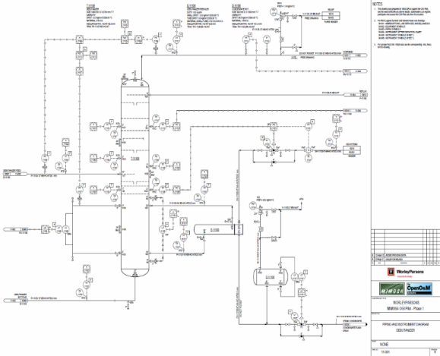
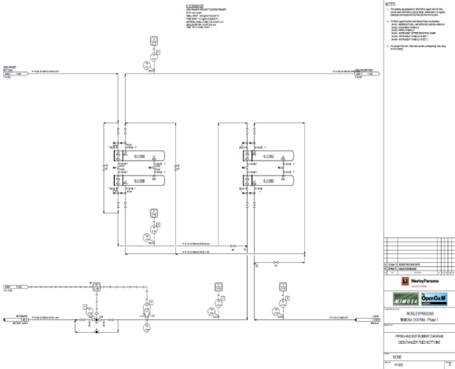
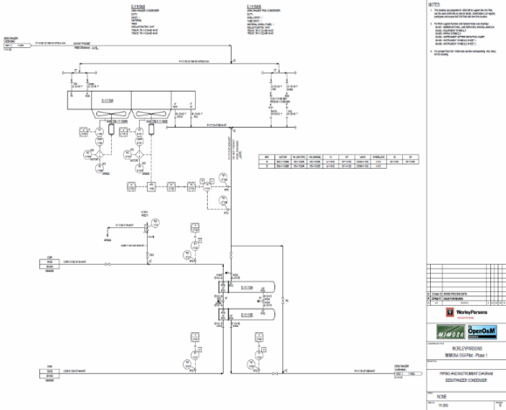
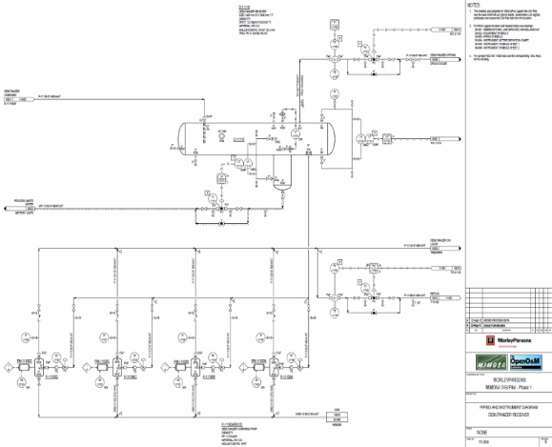
Debutanizer Tower P&IDs – Worley Parsons

Slide 32


OIIE OGI Pilot Sub-Phase 1 Activities 1-4
(October 2018 – February 2019)
Debutanizer Tower Condenser Unit P&ID
Worley Parsons, Fluor
Bentley (CCOM XML)
P&ID Logical Connection information
MIMOSA Structured Digital Asset Interoperability Registry
RFI/RFI Response (Greenfield)
RFI Response – Models
RFI – Functional requirements
Capital Project Asset Installation
Request for Model properties (ISDDs)
Asset instances selected from RFI Response (defined using ISDDs)
Installed on P&ID Tag locations (defined using ISDDs)
Aveva, Hexagon (Proteus XML)
Procure
EPC
OEM

Slide 33



OIIE OGI Pilot Sub-Phase 1 Activities 5-8
(October 2018 – February 2019)
Information Handover
From Capital Project to Operations and Maintenance
Condition Based Maintenance
Remove and Replace
Diagnostics
RFI/RFI Response (Brownfield)
Information Remediation
Over ISBM (Information Service Bus Model)
Prognostics
Advisory Generation

Slide 34
Section End

Slide 35
Digital Ecosystems and the OIIE
Markus Stumptner
Advanced Computing Research Centre
AI and Software Engineering Group

Slide 36

AI and Software Engineering Group
About 20 members
AI + Software Engineering + Data Management
Major topics
  Reasoning about system behaviour
  Information and knowledge management in distributed ecosystems

Slide 37

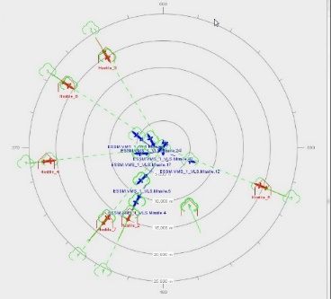








Projects in the Ecosystem Space
OT/IT Interoperability
Digital Information Energy Australia
Gateway
OGI Pilot
Genetic Data Curation
SOA for Future Combat Systems
Automated Modelling for Combat Simulation Ecosystems
Integrated Law Enforcement –
Federated Data Platform

Slide 38
Activities in the OIIE Space
New Use Case for RFI/RFI Response in Greenfield and Brownfield
Industry Standard Datasheet Definitions (ISDDs) Project
  ISDD Build
  ISDD Management and Mapping
  ISDD Use and Reuse
Teaming with Land O'Lakes, OAGi and NIST
  CBM Use Case (Use of JSON and ISO 13374)

Slide 39
Use Case 12: Request for Information and Response in Greenfield and Brownfield
(RFI/RFI Response)

Slide 40

Use Case 12
RFI/RFI Response in Greenfield
RFI/RFI Response in Brownfield Information Remediation
Functional Requirements (RFI)
EPC
OEM
Models Meeting Requirements (RFI Response)
Serial No, Requirements, Known Properties (RFI)
O/O
OEM
Matching Model(s) (RFI Response)

Slide 41
User Stories for Use Case 12 in Greenfield

Slide 42
Story M100: Start Unit Functional Requirements
1.We need to build a light ends unit to remove butane from our incoming crude supply
Debutanizer
PFD and P&ID
Functional Requirements
Client Business Person
Client Engineer
2.a How Much Capacity Do We Need?
b. What will the incoming crude spec be?
A

Slide 43
Story M101: Model Selection
1. We need to buy equipment and instruments meeting or exceeding functional requirements taken from PFD and P&IDs for the new Debutanizer Tower.
2. Send me the Requirements from those documents and I will check with our preferred suppliers.
Requirements (RFI)
Instrument or Equipment Supplier Portals
3.P2M Dialog
Models Meeting Requirements (RFI Response)
Client Engineering Person
Client
Purchasing
Requirements
Debutanizer
PFD and P&ID
A
B

Slide 44
User Story for Use Case 12 in Brownfield Information Remediation

Slide 45
Story M102: Make/Model Match-up
1. We have a large number of instruments in our Debutanizer Tower, but we do not know the Models or many of the Properties.
2. I will send RFIs requesting Manufacturer to send us their corresponding Models and the properties for those models
3. RFIs
4. RFI Responses
Equipment and Instrument OEM
Maintenance and Reliability
Manager
Asset Information Manager

Slide 46
Industry Standard Datasheet Definition (ISDD)

Slide 47
Industry Standard Datasheet Definition (ISDD)
Capture existing Industry Standard Datasheets (ISDs) as machine interpretable business objects that are then fully re-usable, mappable and extensible.
  Provide standard XML exchange schema for exchanging datasheet oriented information
  Mappable to existing OEM and O/O Datasheets
Capture high-value properties from existing, high-value ISDs published by credible industry associations including API, ASME, IEC, ISA, ISO, NORSOK and PIP.
Support Asset’s full life-cycle information management
  Data sheets are not used just for procurement
  Improves ability to procure, install, commission, operate and maintain assets with reduced effort, cost and schedule

Slide 48
Data Sheets
Functional Segments can be associated with data sheets to specify functional requirements
Models can be associated with data sheets to specify characteristics of equipment of that model
Equipment Assets can be associated with data sheets to specify characteristics of that equipment
Segment and Asset Types can have data sheet templates (AttributeSetDefinitions) to support class libraries

Slide 49
Industry Standard Data Sheets (ISDs)
Currently have identified 263 source ISDs in common use
Most commonly identified ISD publishers are listed below
API | 15 (+20 ISO equivalents)
ASME | 2 (+1 ISO equivalent)
IEC | 10
ISA | 166
ISO | 28
NORSOK | 31
PIP | 11

Slide 50
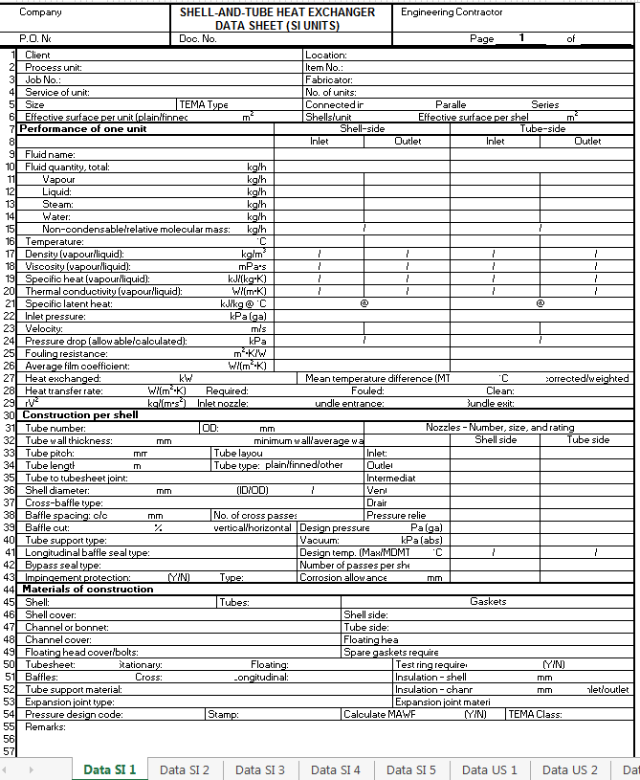
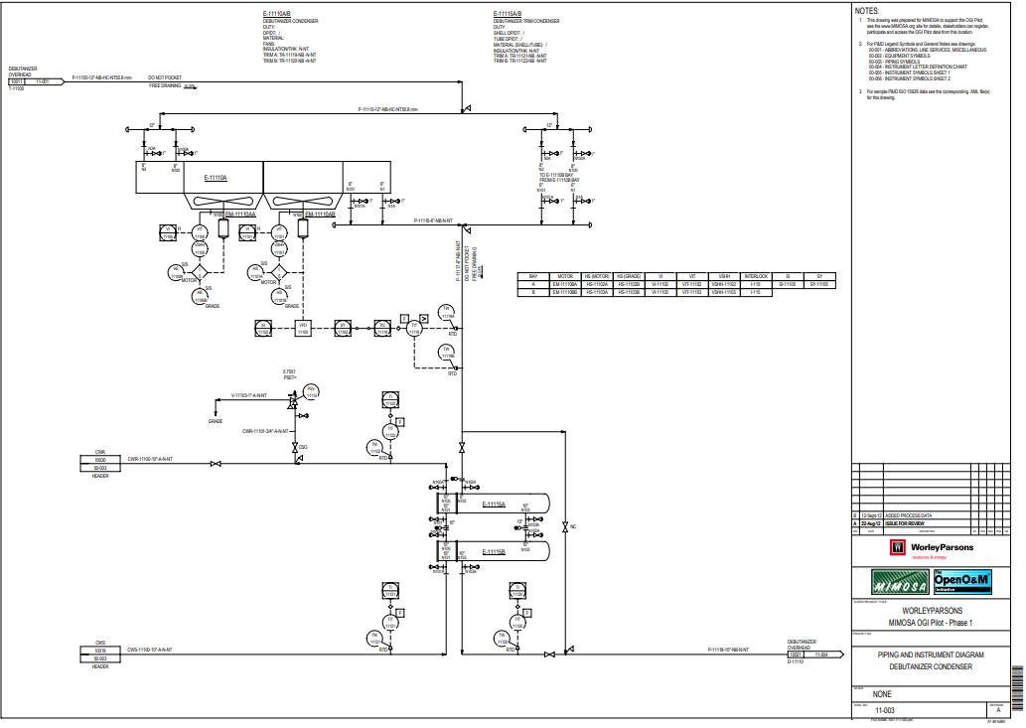
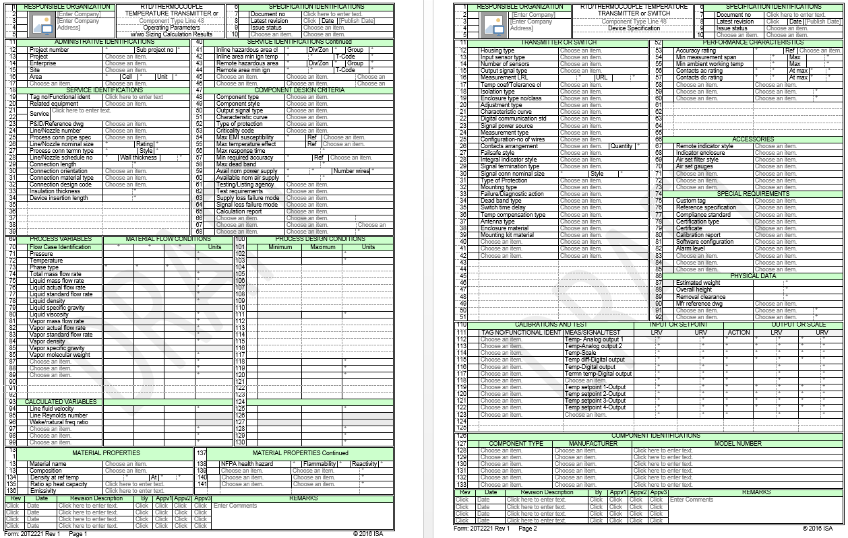
Condenser Unit of Debutanizer Tower P&ID
Equipment class ISD
API 660 Shell and Tube Heat Exchanger Data-sheet
Instrument class ISD
ISA 20T2221 RTD/Thermocouple Temperature Transmitter or Switch Revision 1 Data-sheet

Slide 51
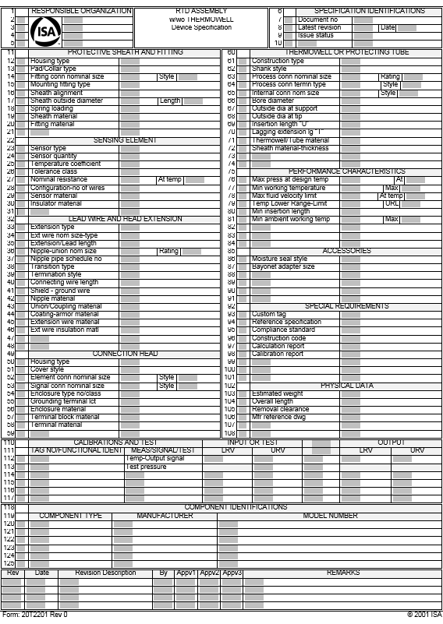
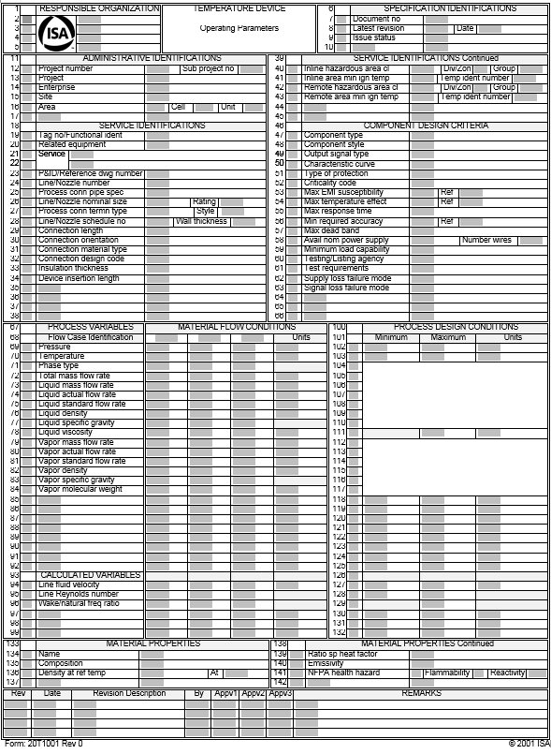
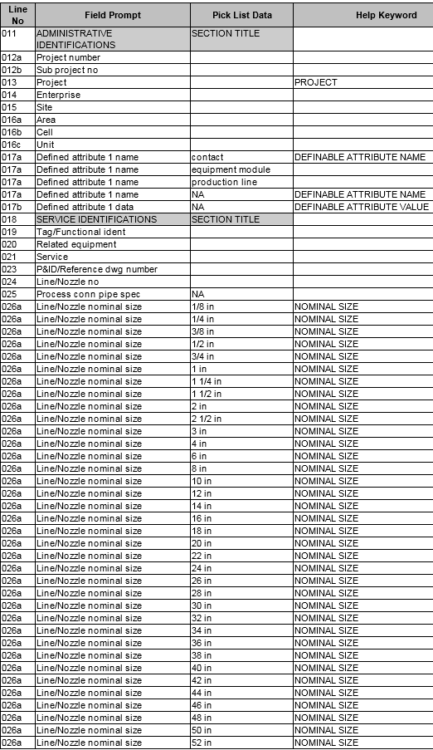

Industry Standard Datasheet Example (ISA Rev 0)
Temperature Transmitter
ISA 20T2221 Device Specifications
ISA 20T1001 Operating Parameters
Datasheet
Datasheet
Picklist
Picklist

Slide 52
Industry Standard Datasheet Example (ISA Rev 1)
Temperature Transmitter
ISA 20T2221 Operating Parameters + Device Specifications
Datasheet + Picklist
Datasheet + Picklist

Slide 53
ISDD Phases
Build
Map
Publish
Use
  ISO 15926 PCA RDL
  Energistics Unit of Measure
  MIMOSA CCOM Reference Data
  ISA 20 Picklists
  USPI CFIHOS RDL
  IEC Common Data Dictionary
  ECCMA Open Technical Dictionary
  MIMOSA Website
  XML
  Excel
  JSON (Work-in-progress)

Slide 54
Building ISDDs

Slide 55
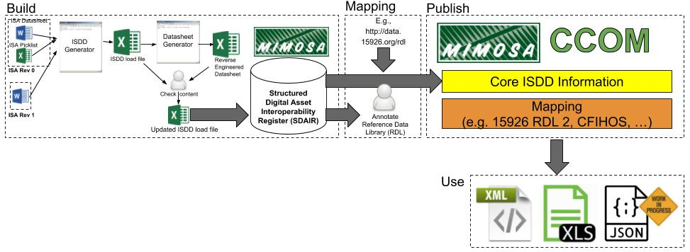
Current ISDD Build Process
Applies to ISDs from all sources ISA (Rev 0, Rev 1), API, IEC..
Degree of automation differs based on the complexity/consistency of the datasheet
ISA highly automatable, API much more difficult
Manual QA review identifies issues with extracted properties and issues/ambiguities in source datasheets
XML–primary CCOM format
Excel Spreadsheet–for Human Readability
JSON–for IoT, light-weight data exchange

Slide 56
Estimated ISDD Build Process Efforts
Estimated level of effort per class for ISA and API ISDs
  ISA-Build ISDDs - 3.5 Hours/Class
  API-Build ISDDs - 3, 7 or 10 Days/Class/Sub-Class
Estimated level of effort per class to “convert” CFIHOS classes
  2 Hours/class assuming CFIHOS logically correct and consistent
  Automated conversion with manual QC review

Slide 57
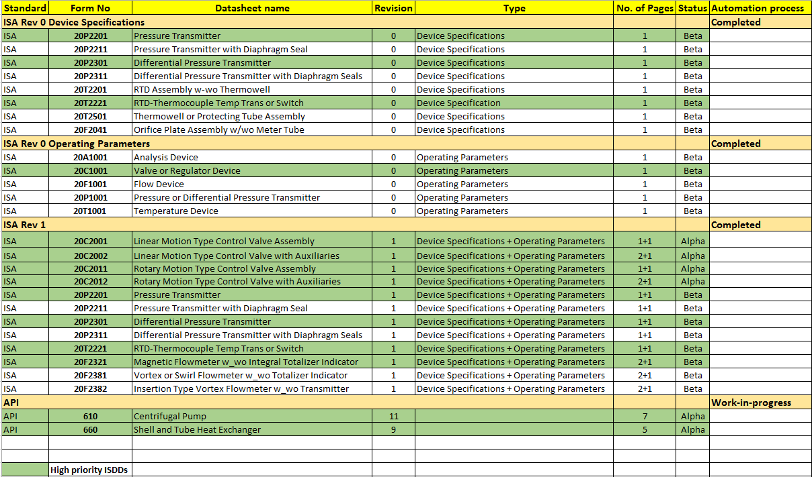
Current ISDD Status

Slide 58
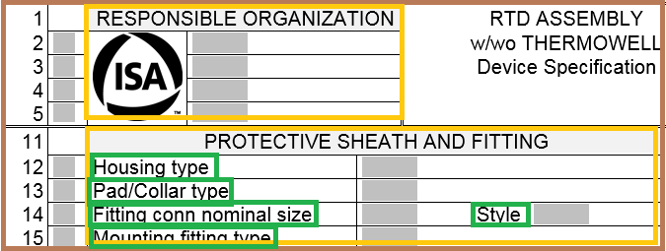
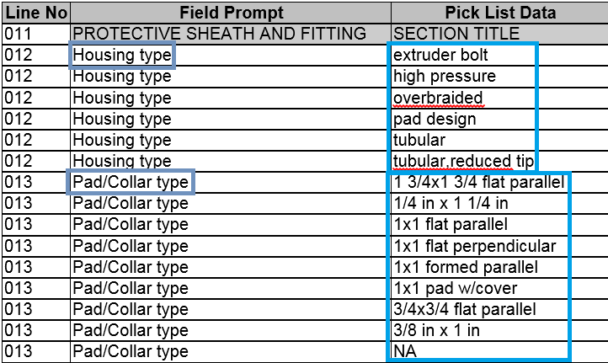
ISDD
Equipment Type
ISA 20T2221 Datasheet
Temperature Transmitter
Attribute Set Definition
Attribute Set Definition
20T2221 Device Specifications
20T1001 Operating Parameters
Attribute Group Definition
RESPONSIBLE ORGANIZATIONS
Attribute Group Definition
PROTECTIVE SHEATH AND FITTING
ISA 20T2221 Picklist
Attribute Definition
Attribute Type
Housing Type (Line 12)
Housing Type
Enumeration
Housing Type
Enumeration Items
Extruder bolt
High pressure
Attribute Definition
Attribute Type
Pad/Collar Type (Line 13)
Pad/Collar Type

Slide 59
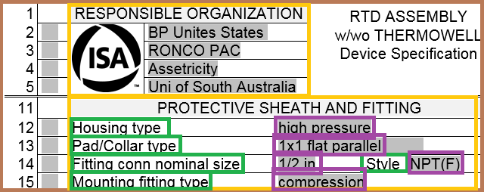
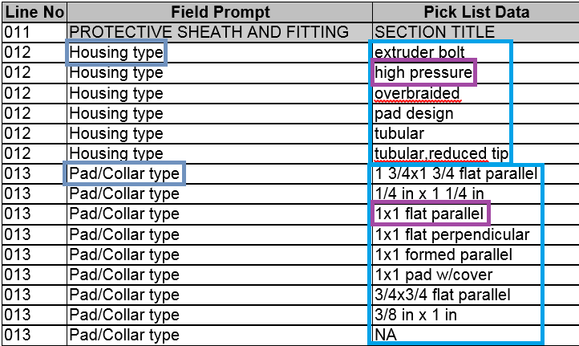
ISDD Instance
Equipment Type
ISA 20T2221 Datasheet
Temperature Transmitter
Attribute Set
Attribute Set
20T2221 Device Specifications
20T1001 Operating Parameters
Attribute Group
RESPONSIBLE ORGANIZATIONS
Attribute Group
PROTECTIVE SHEATH AND FITTING
ISA 20T2221 Picklist
Attribute
Attribute Type
Housing Type = high pressure
Housing Type
Attribute
Enumeration
Pad/Collar Type = 1x1 flat parallel
Housing Type
Attribute
Enumeration Items
Fitting conn nominal size = ½ in
Extruder bolt
Attribute
High pressure
Mounting fitting type = compression
….

Slide 60
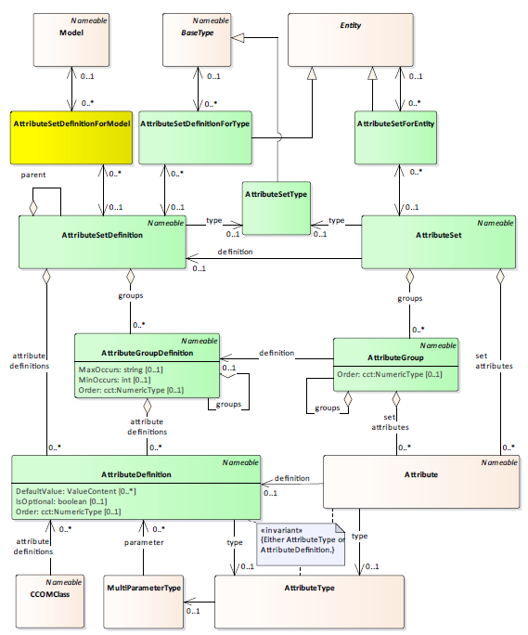
ISDD Definition
ISDD Instance
AttributeSet and Attribute in an ISDD Definition will have their type set to their respective AttributeSetType and AttributeType.
AttributeSet, AttributeGroup and Attribute in an ISDD instance will refer to its definition in the ISDD definition.

Slide 61
Temperature Transmitter
20T2221 Device Specifications
20T2221 Device Specifications
PROTECTIVE SHEATH AND FITTING
PROTECTIVE SHEATH AND FITTING
RESPONSIBLE ORGANIZATIONS
RESPONSIBLE ORGANIZATIONS
Housing Type (Line 12)
Pad/Collar Type (Line 13)
Housing Type = high pressure
Pad/Collar Type = 1x1 flat parallel
Housing Type
Pad/Collar Type

Slide 62
Conformance Testing using ISDD
DATA SHEET DEFINITION (ISDD)
DATA SHEET (ISD)
Property
Req’d
Property
Value
MAX OPERATING TEMPERATURE
Y
MAX OPERATING TEMPERATURE
140
°C
MAX OPERATING PRESSURE
Y
MAX OPERATING PRESSURE
13
bar
MECHANICAL SEAL DIAMETER
Y
SHAFT MATERIAL
N

Slide 63
Mapping ISDDs

Slide 64
Mapping ISDDs
Equipment Type
Shared Reference Data Library
Temperature Transmitter
Attribute Set Definition
Temperature Device
(Equipment Type)
mapping
20T2221 Device Specifications
Attribute Group Definition
Organisation Metadata
(Property Class)
RESPONSIBLE ORGANIZATIONS
Attribute Group Definition
Mappings defined and queried based on MIMOSA CIR specification.
Supports terminological mappings and resolution within an OIIE
Modified CIR spec to enable ISO 22745 conformance.
PROTECTIVE SHEATH AND FITTING
Sheath and Fitting Data
(Property Class)
Attribute Definition
Housing Type
Attribute Type
Temp. Device Housing
(Property Type)
Housing Type
Enumeration
Temp. Device Housing Values
(Picklist)
Housing Type
Extruder Bolt Housing
Enumeration Items
Extruder bolt
High Pressure Bolt Housing
High pressure

Slide 65
Vendor/Supplier-to-ISDD Mapping Process
  E.g. Yokogawa EJX110A Differential Pressure Transmitter
  Relevant Properties, “Picklist” Values, UoMs, etc., for the model
  Similar to building an ISDD
1. Select Model Specification/ Datasheet
2. Create CCOM Representation
4. Map Model Information to ISDD Properties
3. Identify Relevant ISDDs
  Map the model Properties, “Picklist” values, etc. to those of the identified ISDDs in the CCOM representation
  E.g. ISA 20P2301 Differential Pressure Device Specifications

Slide 66
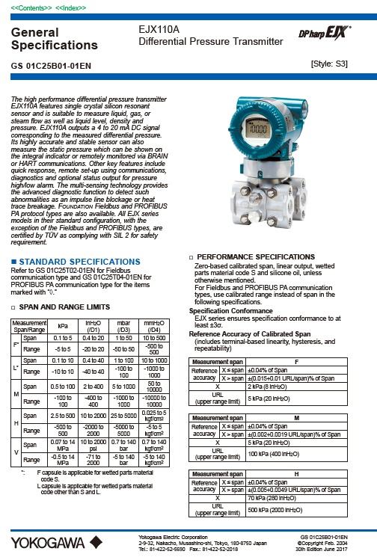
1. Select a Model Specification
The EJX110A Differential Pressure Transmitter specification defines a type of differential pressure transmitter, where any physical device of this type is in a particular configuration as described by model specification suffix code.
Only when a particular configuration or ‘model variant’ is selected do all of the properties defined by the specification have concrete values.

Slide 67
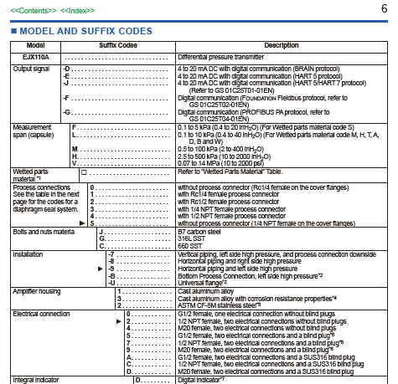
2. Create CCOM Representation
Attribute Set Definition
Model
Equipment Type
EJX110A General Specifications
Yokogawa - EJX110A
Diff. Pressure Transmitter
Attribute Group Definition
MODEL AND SUFFIX CODES
Attribute Definition
Attribute Type
Output signal [Level 1]
Output Signal
Enumeration
Output Signal
Enumeration Items
4 to 20 mA DC, w/ digital (BRAIN) [-D]
Digital, FOUNDATION protocol [-F]
Attribute Definition
Attribute Type
Measurement span (capsule) [level 2]
Measurement span
Enumeration
Measurement span
Enumeration Items
Attribute Group Definition
0.1 to 5kPA (0.4 to 20 inH₂O) [F]
OPTIONAL CODES
0.1 to 10kPa (0.4 to 40 inH₂O) [L]

Slide 68
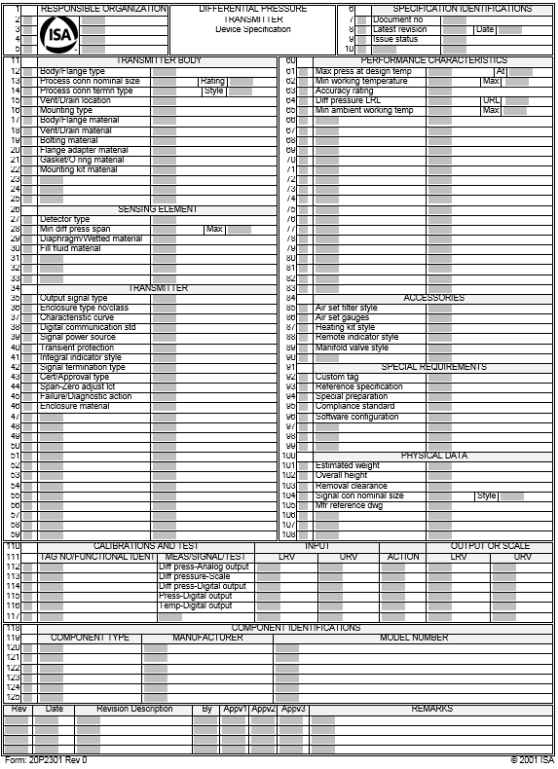
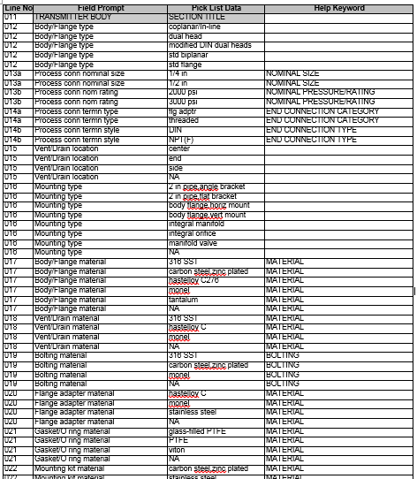
3. Identify Relevant ISDDs
Equipment Type
Diff. Pressure Transmitter
20P2301 Device Specifications
Attribute Set Definition
Datasheet
20P2301 Device Specifications
Attribute Group Definition
Picklist
TRANSMITTER
Attribute Definition
Attribute Type
Output signal type (Line 35)
Output signal type
Enumeration
Output signal type
Attribute Definition
Enumeration Items
Min diff pressure span (Line 28)
Attribute Type
analog current
digital multi-variable
Min diff pressure span
Enumeration
Min diff pressure span
Enumeration Items
0.4

Slide 69
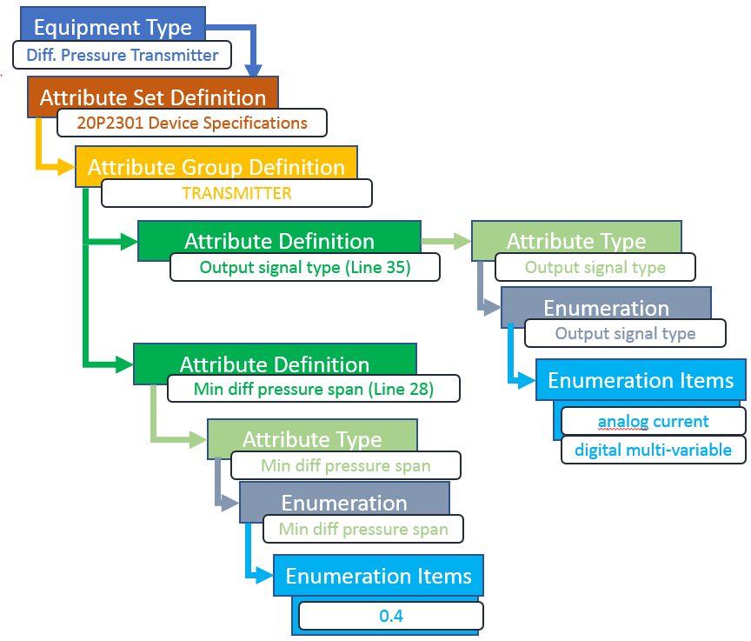
4. Map Model Information to ISDD Properties
Attribute Set Definition
Model
Equipment Type
EJX110A General Specifications
Yokogawa - EJX110A
Diff. Pressure Transmitter
Attribute Group Definition
MODEL AND SUFFIX CODES
Attribute Definition
Attribute Type
Output signal [Level 1]
Output Signal
Enumeration
Output Signal
Enumeration Items
4 to 20 mA DC, w/ digital (BRAIN) [-D]
Digital, FOUNDATION protocol [-F]
Attribute Definition
Attribute Type
Measurement span (capsule) [level 2]
Measurement span
Enumeration
Measurement span
Enumeration Items
Attribute Group Definition
0.1 to 5kPA (0.4 to 20 inH₂O) [F]
OPTIONAL CODES
0.1 to 10kPa (0.4 to 40 inH₂O) [L]

Slide 70
Publishing ISDDs

Slide 71
Publishing ISDDs
Downloadable from MIMOSA website as a set of ZIP archives.
Each (version of an) ISDD will have its own archive containing the following four files:
  “Load” file in Excel format - provides a simplified view for aiding understanding.
  CCOM XML - the normative data.
  CCOM data in Excel format - non-normative, considered as documentation to aid understanding.
  Reverse engineered single column datasheet in Excel - produced from the ISDD load file, similar to the original datasheet.
Additional CCOM XML files containing reference data shared across ISDDs will also be provided, for example, a CCOM XML file for ISA-based property types will be provided. All ISA-based ISDDs will reference this file.
Due to copyright and licensing, original ISDs will not be made available

Slide 72
Using ISDDs
Re-visiting User Stories for RFI/RFI response
Show-casing the use of ISDDs

Slide 73
Story M001:OIIE Configuration – ISDD Selection
1. What datasheets (ISDDs) do we need in our OIIE instance?
2. We need API 610 Centrifugal Pump, ISA 20C1001 (Control Valve, OP), …
Client Ecosystem Admin
Client Engineer??
(May be EPC)
3. ISDD selection
ISDD Defns.
MIMOSA Reference OIIE Instance
(InteropRegister and ISBM @ mimosa.org)
Client OIIE System
4. Provisioning of local system with ISDD definitions

Slide 74
Story M002:OIIE Configuration – ISDD Customisation
1. What non-standard properties do we need in the datasheets?
4. Do we need to restrict the export of any datasheet properties?
2. We need properties X, Y, Z for the Centrifugal Pump
Client Ecosystem Admin
Client Engineer??
(May be EPC)
Client Business Manager??
ISDD defns.
3. ISDD extension
dialog
6. Property restriction config dialog
5. Properties A, B, C should only be shared with partners.
Client OIIE System
Extended ISDD
definitions

Slide 75
Story M100:Start Unit Functional Requirements
ISDD Instances
1.We need to build a light ends unit to remove butane from our incoming crude supply
Debutanizer
PFD and P&ID
Functional Requirements
Client Business Person
Client Engineer
(May be EPC)
2.a How Much Capacity Do We Need?
b. What will the incoming crude spec be?
A
Notes:
It is critical to understand how the functional requirements are established during a capital project and later included in the O&M environment, as they provide the requirements which drive purchases of devices and also establish the operational context for devices once they have been installed. It is also important to know that owner/operators generally assign their own Asset Tags, which they use instead of Serial Numbers provided by any OEM. In an IIOT or Industry 4.0 scenario, the owner/operator will generally be seeking help associated with a Functional Location Tag and/or an Asset Tag, rather than a Serial Number. The OEM needs to be prepared to participate in M2M dialogs with this understanding and to help the Owner/Operator establish the pairing between Serial Numbers and Asset Tags, as well as understanding how to help diagnose problems associated with Functional Location Tags. There may also be a business opportunity to help populate the Owner/Operator systems with more information about the devices and equipment, which they will otherwise be forced to enter on a manual basis or try to operate with incomplete information. The Functional Requirements information which is started in this Storyboard is often capture in a PFD and that information will be flowing into all of the subsequent Storyboard Interactions. The first step in that flow starts with connector A.

Slide 76
Story M101:Model Selection
1. We need to buy equipment and instruments meeting or exceeding functional requirements taken from PFD and P&IDs for the new Debutanizer Tower.
2. Send me the Requirements from those documents and I will check with our preferred suppliers.
Requirements
Instrument or Equipment Supplier Portals
3.P2M Dialog
Models Meeting Requirements
Client Engineering Person
Client
Purchasing
(May be EPC)
Requirements
ISDD Instances
for Models
Debutanizer
PFD and P&ID
A
B
ISDD defns.
for Models
ISDD Instances
Functional places
Notes:
The preliminary Functional Requirements information established in Storyboard Slide 1 is flowing to Slide 2 using Connector A. In this case, we are assuming that Client Engineering Person is starting with PFD information generated in Slide 1. This is then converted into P&ID level information, where a Functional/Physical level of detail is included. The Functional/Physical level of detail is where specific Functional Locations are identified for specific equipment and devices, (in this case, specifically including Instruments), which is where the functional/business requirements come from for OEM devices and equipment. This information flows through Connector B to the subsequent Storyboard Slide 3, where As Built information is added to the same Functional/Physical requirements. Over time this results in what is called a “Digital Twin” digitally modeling the physical Unit.

Slide 77



OIIE/OGI Standardized Use Case Structure
Use
Cases
Scenarios
Events
Background
Actors
Individual Message Exchange
Scope
Preconditions
Successful End
Condition
Data Content
Data Formats
Reference Data
(OIIE) Events
Information Service
Bus Configuration
Specific Data Content
CCOM BODS are an implementation of Events
Required data processing
Expected Response Event (if any)
  Actors
  Triggers
  Process Workflows
  Scenarios
User Stories
High-level
Pictographic
Depict 1 or more Use Cases, Scenarios, and/or Events
Actors, Systems, Exchanges, Data
User Stories

Slide 78
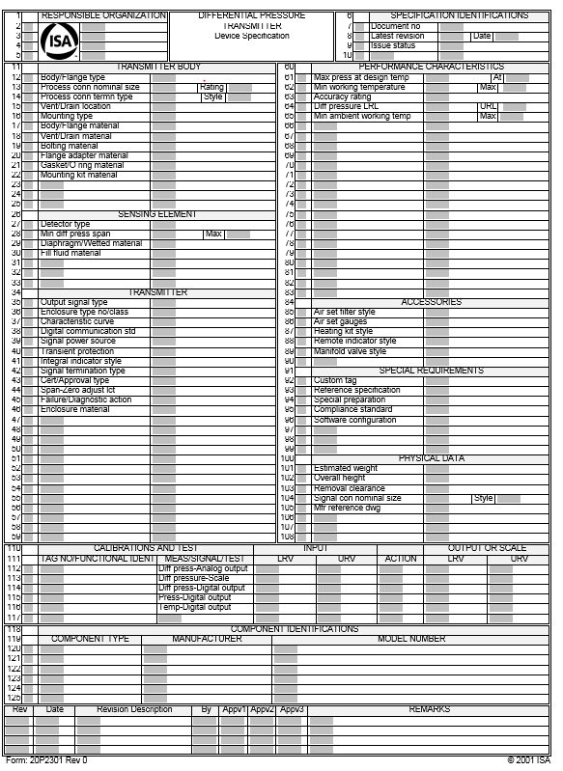
Use Case 12: RFI/RFI Response in
Brownfield Information Remediation
Scenario: RFI for Possible Models of an Asset
Scenario: RFI Standard Model Properties
Event 1: Process Model Request For Asset
Event 3: Get Model Datasheets
Event 2: Acknowledge Model Request For Asset
Event 4: Show Standard Datasheets

Slide 79
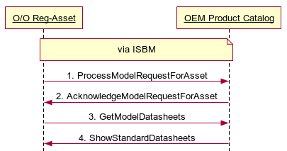
Use Case 12:
Brownfield Information Remediation
Scenario: RFI for Possible Models of an Asset
Scenario: RFI Standard Model Properties
Event 1: Process Model Request For Asset
Event 3: Get Model Datasheets
Event 2: Acknowledge Model Request For Asset
Event 4: Show Standard Datasheets

Slide 80

Simplified Schema of ISDD
<?xml version="1.0" encoding="UTF-8"?>
<xs:schema xmlns:xs="http://www.w3.org/2001/XMLSchema" xmlns="http://www.mimosa.org/ccom4-isdd">
<xs:include schemaLocation="isdd.xsd"/>
<xs:complexType name="ISA-20T2201" abstract="false">
<xs:complexContent>
<xs:extension base="ISDDInstance">
<xs:sequence>
<xs:element name="RESPONSIBLE-ORGANIZATIONS" minOccurs="1" maxOccurs="1">
<xs:complexType>
<xs:complexContent>
<xs:extension base="ISDDGroup">
<xs:sequence>
<xs:element name="RESPONSIBLE-ORGANIZATION-1" minOccurs="0">
<xs:complexType>
<xs:simpleContent> <xs:restriction base="ISDDAttribute"/> </xs:simpleContent>
</xs:complexType>
</xs:element>
……..
…….
</xs:sequence>
</xs:extension>
</xs:complexContent>
</xs:complexType>
</xs:element>
<xs:element name="SPECIFICATION-IDENTIFICATIONS" minOccurs="1" maxOccurs="1">
<xs:complexType>
<xs:complexContent>
<xs:extension base="ISDDGroup">
<xs:sequence>
<xs:element name="Document-No." minOccurs="0">
<xs:complexType>
<xs:simpleContent><xs:restriction base="ISDDAttribute"/></xs:simpleContent>
</xs:complexType>
</xs:element>
……..
……..
</xs:sequence>
</xs:extension>
</xs:complexContent>
</xs:complexType>
</xs:element>
……..
………
</xs:sequence>
</xs:extension>
</xs:complexContent>
</xs:complexType>
</xs:schema>
CCOM
XSLT
CCOM
ISDD
Simplified Schema of ISDD
instance
instance
CCOM
CCOM
XSLT
ISDD Instance
Simplified ISDD Instance

Slide 81
CCOM BODs Conceptual Approach Example
Agent
Owner/Operator
BOD Noun
Process Model Request For Asset
Model Request (Request For Information)
from
From Agent (Agent: Owner/Operator)
*Request For Information
Respond By = 2018-06-06
type
Request Type
Model Request for Asset
From Agent (Agent: Owner/Operator)
about
Asset
Serial No. = XYZ0001
has
Attribute Set
has
Attribute Group
Respond By (2018-06-06)
Asset (Asset: with S/N XYZ0001)
installed asset
has
Serial Number (XYZ0001)
Asset Installation Event
Installed At: 2017-06-06
Attribute
Model Spec. No. = …
Functional Location (Segment: Functional Location TS001)
installed location
Segment
Functional Location TS001
has
Attribute Set
ISDD Instance
has
Attribute Group
Asset Installation Date (2017-06-06)
Functional Requirements (Attribute Set: ISDD Instance)
has
Group (Attribute Group)
Attribute
Temp. Max. = 90º
Attribute
Temp. Min. = -15º
Attribute (Attribute: Temp. Min. = -15º)
Attribute (Attribute: Temp. Max. = 90º)
Notes:
* Indicates object of interest
A standard CCOM XML dump of the left-hand side would result in a deeply nested structure containing everything on the left.
For a BOD, the depth is restricted and important information explicitly represented at the top-level of the “noun”, even if it is far away from the main object of interest (i.e. the Request for Information object)
If the first degree of separation is always nested for the primary object of interest, there may be some duplication of references. (e.g. ‘From Agent’)
This nested information can be left out as it can be reconstructed from the BOD contents.

Slide 82
BOD: ProcessModelRequestForAsset
Brownfield Information Remediation
Business Object Document
Application Area
Scenario: RFI for Possible Models of an Asset
Scenario: RFI Standard Model Properties
Event 1: Process Model Request For Asset
Event 3: Get Model Datasheets
Data Area
Event 2: Acknowledge Model Request For Asset
Event 4: Show Standard Datasheets
Verb: Process
Simplified ISDD Instance XML (Model Information)
Noun: ModelRequestForAsset
<ISDDInstance xsi:type="ISA20T2201"
xmlns="http://www.mimosa.org/ccom4-isdd"
xmlns:xsi="http://www.w3.org/2001/XMLSchema-instance">
<UUID>83641788-187f-4be1-96bf-c1bfe517f94f</UUID>
<EntityUUID>78807960-cf6a-4524-94bd-b06d0cc1405d</EntityUUID>
<EntityShortName>RTD Assembly-T1</EntityShortName>
<RESPONSIBLE-ORGANIZATIONS>
<RESPONSIBLE-ORGANIZATION-1>Example O/O</RESPONSIBLE-ORGANIZATION-1>
</RESPONSIBLE-ORGANIZATIONS>
<SPECIFICATION-IDENTIFICATIONS>
<DocumentNo>1002468</DocumentNo>
…
</SPECIFICATION-IDENTIFICATIONS>
<PROTECTIVE-SHEATH-AND-FITTING>
<HousingType>extruder bolt</HousingType>
<PadCollarType>1x1 flat parallel</PadCollarType>
<FittingConnNominalSize>1/8 inch</FittingConnNominalSize>
<FittingConnTermnStyle>NF thd</FittingConnTermnStyle>
…
</PROTECTIVE-SHEATH-AND-FITTING>
…
</ISDDInstance>
MIMOSA CCOM
Entity
(e.g. Asset, Functional Location)
ISDD Instance
(Functional Requirements)
ISDD Instance
(Model Information)
ISDD Instance
(Functional Requirements)
ISDD Instance
(Model Information)

Slide 83
BOD: ProcessModelRequestForAsset
Brownfield Information Remediation
With Multiple Devices
Application Area
Scenario: RFI for Possible Models of an Asset
Scenario: RFI Standard Model Properties
Event 1: Process Model Request For Asset
Event 3: Get Model Datasheets
Data Area
Verb: Process
Event 2: Acknowledge Model Request For Asset
Event 4: Show Standard Datasheets
Noun: ModelRequestForAsset
MIMOSA CCOM
Entity: Pressure Transmitter
ISDD Instance
ISDD Instance
ISDD Instance
(Operating Parameters)
ISDD Instance
(Device Specifications)
ISA 20P2201
Operating Parameters
ISA 20P1001
Device Specifications
MIMOSA CCOM
Entity: Temperature Transmitter
ISDD Instance
ISDD Instance
ISDD Instance
(Operating Parameters)
ISDD Instance
(Device Specifications)
ISA 20T2201
Operating Parameters
ISA 20T1001
Device Specifications

Slide 84
How do Owner/Operators and Suppliers use ISDDs?
Use ISDD as-is
Extend ISDDs (for custom properties)
Re-use ISDDs (for common properties)
Restrict ISDDs

Slide 85
Extending an ISDD

Slide 86
ISDDs Support Extensions
Extensions through single inheritance
Allow common properties to be “grouped” together at an equipment super class
  Thus changes at a super class ISDD are also reflected in sub class ISDD
  Reduces work for ISDD authoring (as long as a suitable equipment taxonomy is in place)
Owner/Operator Extensions
Project Extensions

Slide 87
Re-using ISDDs

Slide 88
ISDDs Support Re-use (CCOM 4.1 onwards)
Reuse of Attribute (Set/Group) Definitions across many different entity types
More flexible reuse than single inheritance ‘parent’ relationship
Ability to reuse multiple attribute sets
Reduce duplication of Attribute (Set/Group) Definitions
Copy of
includes
OEM Metadata
for
Device (Type)
parent
Extended Metadata
Cannot modify
includes
Temp. Trans. Properties
for
Temperature Transmitter
Pressure Transmitter
parent
XJC Properties
for
OEM Model XJC Temp. Trans.
group
Aim to avoid this
type of duplication.
OEM Metadata

Slide 89
ISDD Path Forward
Use ISDDs to define the property sets associated with all Functional Locations, Models and Uniquely Identified Assets
Allow new ISDD versions to be applied to existing Sites, Areas and Units under an MoC process
Use ISDDs for packages
ISDD Team will
  develop, publish and maintain most important ISDDs
  develop and publish associated documentation for each ISDD it publishes.
  develop and publish requirements documentation
  develop associated validation process, using OIIE/OGI Pilot testbed
Future candidate ISDDs can then be built by anyone and submitted as candidates for validation and publication by MIMOSA

Slide 90
ISDD Build and Use Plan for 2018/2019
Numbers of Properties on ISDs
All properties needed for digitalization
ISA- 150-350
API- 100-900*
75 ISA Rev 1 Sheets
OIIE/OGI Pilot
Sub-Phase 1
A
+5
O
t
h
e
r
I
S
D
D
S
B
+25 ISA Rev 1 Sheets
OIIE/OGI Pilot
Sub-Phase 2
C
+15
O
t
h
e
r
I
S
D
D
S
D
+ISDDs based on CFIHOS Classes
Business-Driven Work Arounds
CFIHOS
Limited number of properties based on current industry use practices
Will work with members and industry to prioritize Sets B and D and work around strategy for all remaining classes.
ISA Rev 1 Sheets can now be converted to ISDDs through mostly automatic processing.

Slide 91
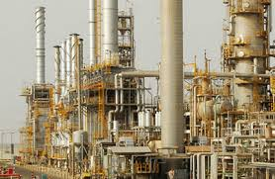
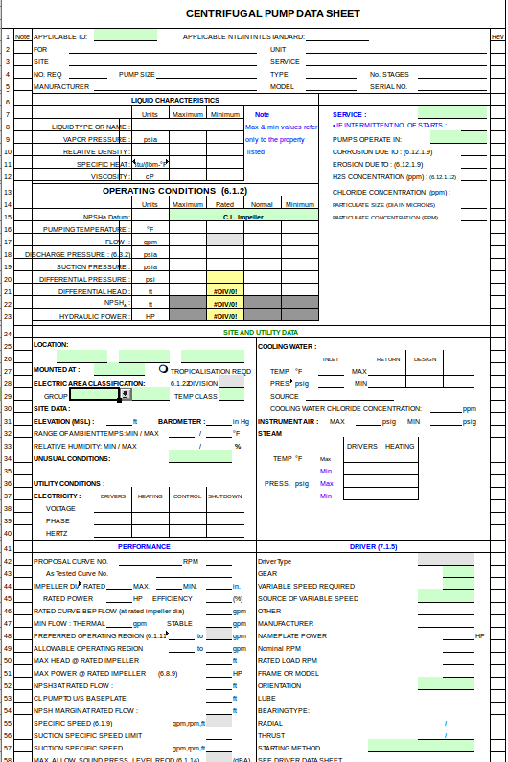
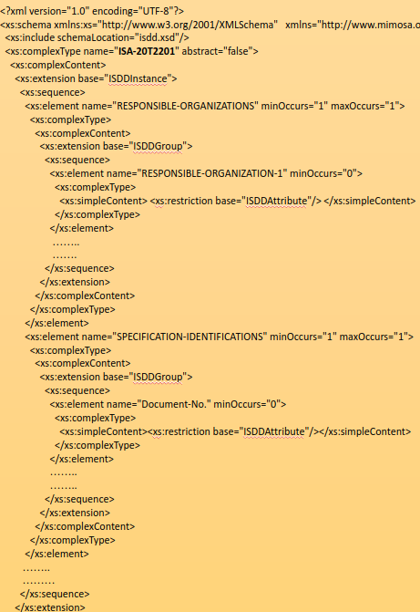
Package ISDDs: The Bigger Picture
Complex Unit
Equipment
Packages
Devices &
Equipment
Pumping
Package
Standardised ISDD Group for Package
ISDDs for Devices & Equipment

Slide 92
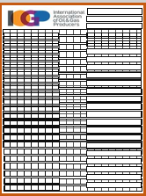
Business Object Document for Packages
BOD: ProcessModelRequestforPackage ProcessModelRequestForPackage
Application Area
Use Case:
Make-Model Match-Up (Package)
Data Area
Verb: Process
Scenario: RFI for Possible Models for Package
Scenario: RFI Standard Model Properties
Noun: ModelRequestForPackage
Event 1: Process Model Request For Package
Event 3: Get Model Datasheets
MIMOSA CCOM
Event 2: Acknowledge Model Request For Package
Event 4: Show Standard Datasheets
Entity: VF AC Drive
Package
ISDD Instance
ISDD Instances
Use case for Make-Model Match-Up
Scenarios for individual devices, equipment and packages.
Scenario for retrieving model datasheets is reused across use cases.
BOD for packages ensures the request is treated as a whole
Entity: Controller
ISDD Instances
Entity: Centrifugal Pump
ISDD Instances

Slide 93
Use Cases 7 & 14:
Condition Based Maintenance & IIoT

Slide 94
Open Industrial Interoperability Ecosystem Use Cases for Condition Based Maintenance
Currently, three use cases related to CBM:
  Use Case 5: Asset Installation/Removal Updates
  Use Case 7: Condition Based Maintenance Triggering
  Use Case 14: Condition Based Maintenance Information Collection
Collectively describe the:
  collection of measurement data: Scenarios 29, 30, 31, 32
  generation of diagnostics, prognostics, and advisories: Scenarios 14
  creation of a work order to repair/replace the equipment: Scenarios 15, 16
  replacement of the equipment that will/has fail(ed): Scenarios 10, 11
Assume other use cases (handover/provisioning) as prerequisites that set up the context in which CBM operates
  Context maintained on event-driven basis (Configuration Change)

Slide 95
Contextualization for Open Industrial Interoperability Ecosystem using MIMOSA CCOM 4.x, ISA, OAGi, ISO and IEC Standards
Process Engineering – (CCOM Segment Networks) – PFDs
  Work Processes followed for CAPEX and OPEX (Intra and Inter-Enterprise)
  Production Process to be supported by Plant/Platform/Facility
Functional/Systems Engineering – (CCOM Segment Networks) – P&IDs , other schema
  System of Systems
  Systems (Functional Packages)
  Functional Locations (P&ID Tag)
  Components
  Sensors
Models – (CCOM Model) – Used for MFG Model and Package Model
Serialized Equipment & Devices – (CCOM Assets installed in CCOM Functional Locations)
Multiple Breakdown Structures as Needed – Taxonomic views of same CCOM objects
  Enterprise Breakdown – Enterprise/Area/Unit (ISA 95/88)
  Maintenance Breakdown Structure – (eg ISO 14224)
ISDDs – (Standardized) Property Sets for ALL Functional Locations, Equipment and Devices
IIOT – Data captured by Sensors is Contextualized by ALL of Above

Slide 96

Example—Segments and Asset Configuration
Organization
UniSA Farm Co.
Site
Mawson Lakes
Segment
Holding Tank
T-001
AssetSegmentEvent
Install
8 Jan 2018
Asset
Tank
Serial # TXZ-738
Model
Tank TXZ Series
Manufacturer
Parts and Associated
Segment
Pasteurizer
P-001
AssetSegmentEvent
Install
30 Jan 2018
Asset
Pasteurizer
Serial # PZR-3246
Model
Pasteurizer
PZR 5000
Manufacturer
UniSA Parts Services
Breakdown Structure
Primary
Segment
Holding Tank
T-002
AssetSegmentEvent
Remove
10 Jan 2018
Asset
Tank
Serial # TYA-234
Model
Tank TYA
AssetSegmentEvent
Install
12 Jan 2018
Asset
Tank
Serial # TYA-637

Slide 97
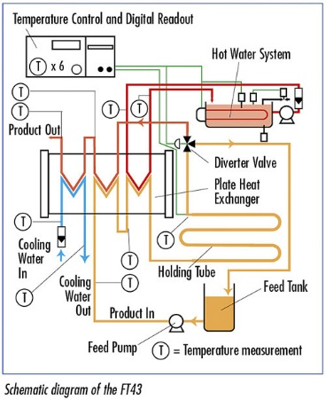
Example—Components & Measurement Locations
Asset
Pasteurizer
Serial # PZR-3246
Asset
Tank
Serial # MT-456
Asset
Pump
Serial # PF332
Asset
Tube
Asset
Temp. Sensor
Serial # TS-999
Transducer
Model
Pasteurizer
PZR 5000
Measurement Location
Temp. Loc. 1
AssetSegmentEvent
Install
1 Jan 2018
AssetSegmentEvent
Install
1 Jan 2018
AssetSegmentEvent
Install
1 Jan 2018
AssetSegmentEvent
Install
1 Jan 2018
Supports both Asset-
and Segment-based
MeasurementLocations
Segment
Feed Tank T1
Segment
Feed Pump P2
Segment
Product In Tube
PIT 3
Segment
Temperature Sensor TS-1
Breakdown Structure
Primary
Segment
Temperature Sensor TS-2
Measurement Location
Temp. Loc. 1

Slide 98
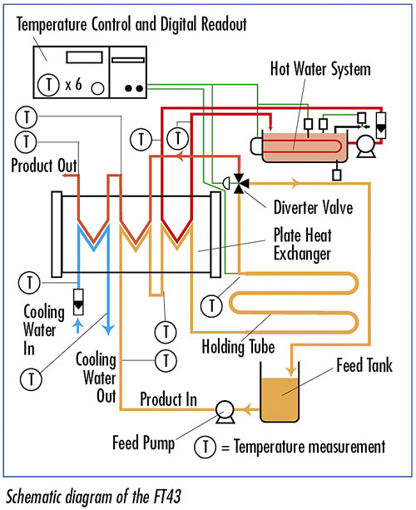
Example—Mesh Networks
Model
Pasteurizer
PZR 5000
from
Segment
T1 Outlet
parent
Segment
Feed Tank T1
Segment Connection
Segment
P2 Inlet
Segment Mesh
PZR Connections
to
parent
Segment
Feed Pump P2
from
Segment
P2 Outlet
parent
And similar at
the Asset level
Segment Connection
Segment
PIT 3 Inlet
parent
Segment
Product In Tube
PIT 3
to

Slide 99
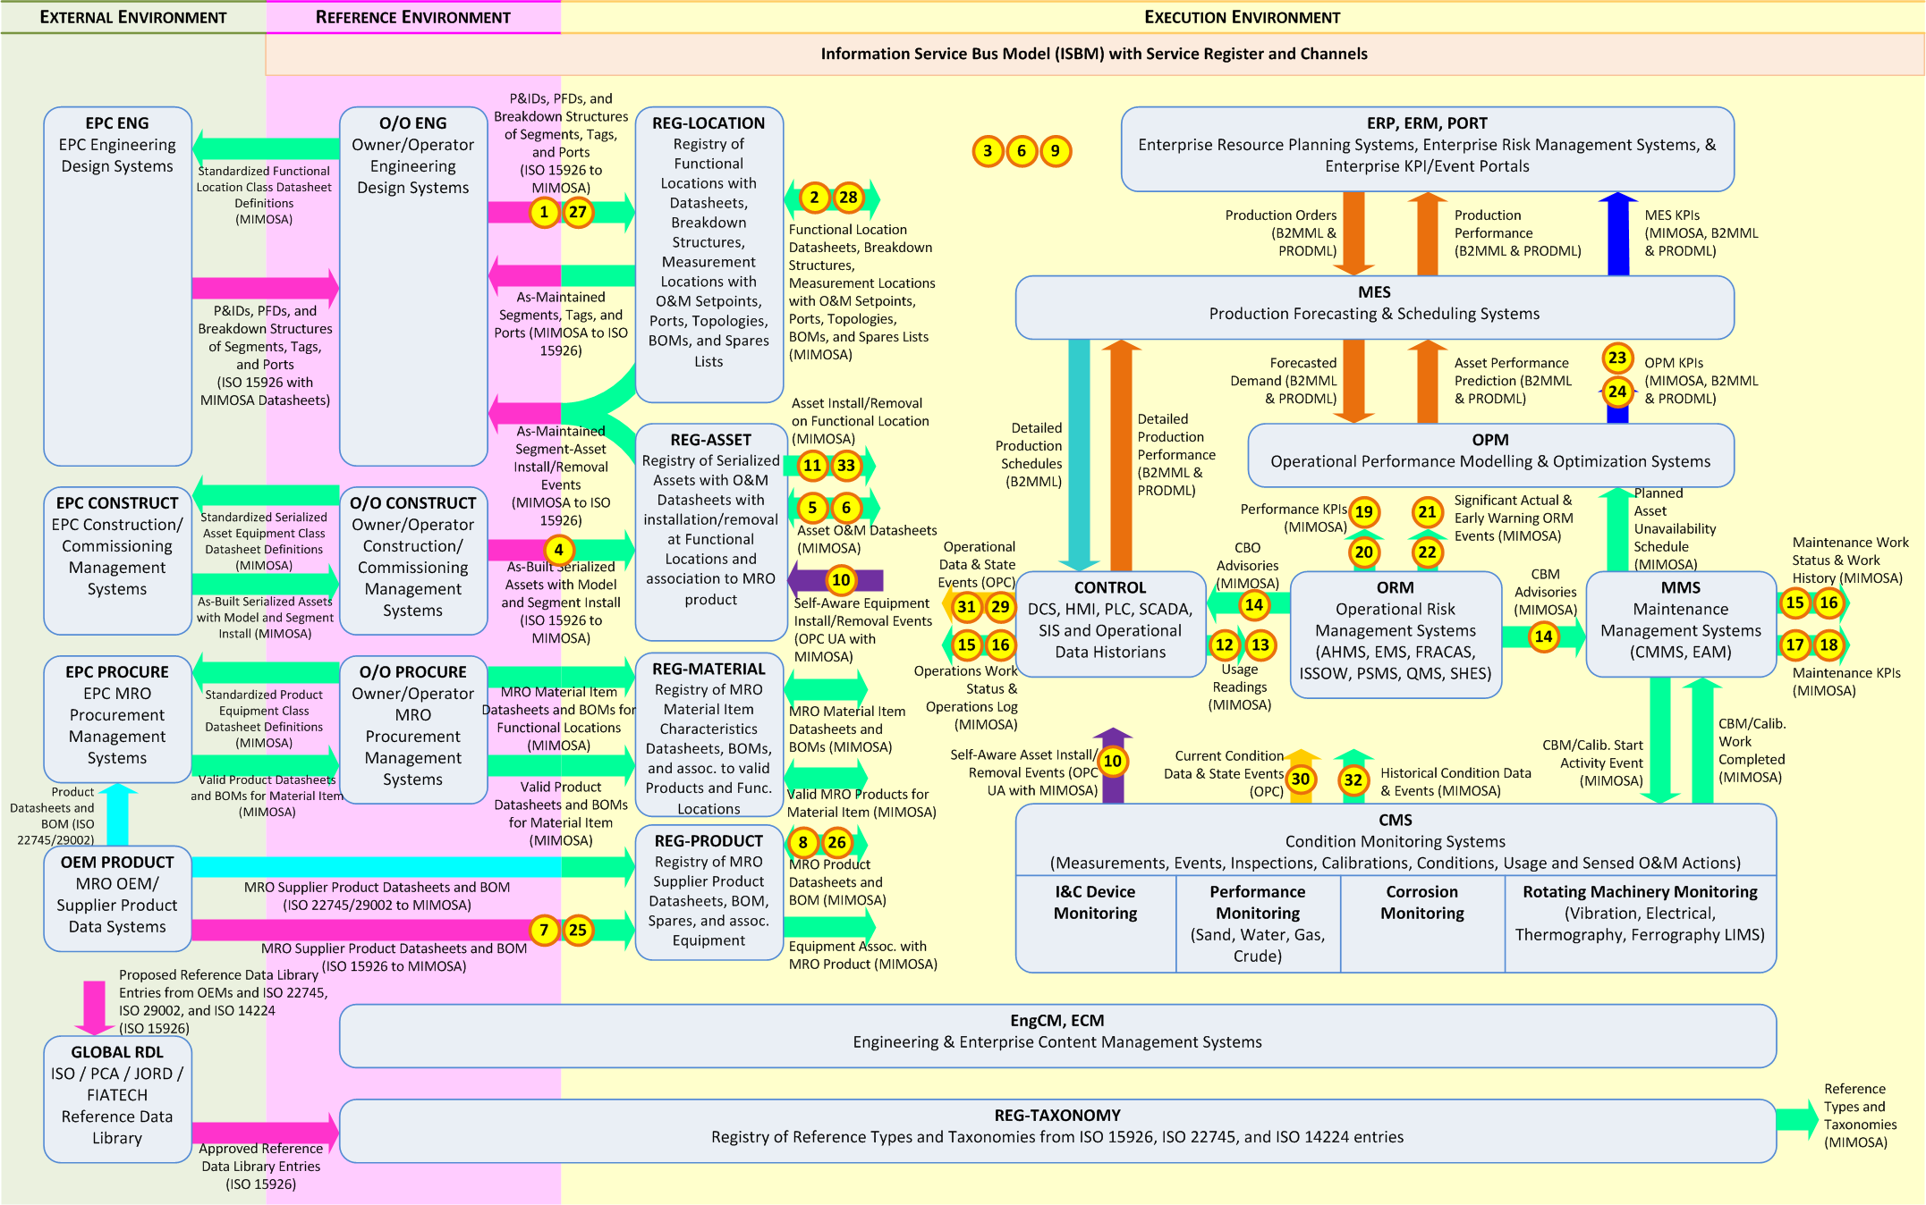
OIIE Systems and Scenarios Landscape
SDAIR

Slide 100








Condition Based Maintenance and IIoT
Registry of digital asset data for contextualisation.
Owner/Operator
Device Manufacturer Supplying Remote Diagnostic/Prognostic/Advisory Support
Internally may have some or none of these systems.
Intra-Enterprise ISBM
May be same physical instance as the intra-enterprise ISBM
SDAIR
ERP
Operational Risk
Management System
Automation and Control
HSE and Operation Monitoring
Prognostic & Health Management
Inter-Enterprise
via ISBM
HSE and Operation Monitoring
Automated System Bus
Maintenance
Management System
Prognostic & Health Management
Device
Device
Sensor/ Transducer
IIoT
Device
Supports remote queries for measurement data and publishes advisories via ISBM.
Support for different protocols as required by industry.
IIoT
Device
IIoT
Device
Support for different protocols as required by industry.
Notes:
Architectural diagram
Sensors -> Measurements -> Diagnostics/Prognostics (Analysis) -> Advisory (Operational Risk Management System) -> Maintenance Management System
Diagnostics/Prognostics may come from same “chip”
Local diagnostic/advisory (Control System and/or ISBM)
Inter-enterprise diagnostic/measurement info: query-based over ISBM
Show both OPC UA and CCOM REST/JSON API

Slide 101
User Stories for CBM Use Cases

Slide 102
CBM According to ISO 13374
Machine condition assessment data processing & information flow blocks.
Sensor / Transducer / Manual Entry
External Systems,
Data Archiving, & Block Configuration
Technical Displays & Information Presentation
DATA ACQUISITION (DA)
DATA MANIPULATION (DM)
STATE DETECTION (SD)
HEALTH ASSESSMENT (HA)
PROGNOSTICS ASSESSMENT (PA)
ADVISORY GENERATION (AG)

Slide 103
Story M200: Condition Information Collection (Trusted)
Device/Instrument
1. Condition Information
Operational Risk Management
(ORM) System
B
Equipment XXX
Sensor/Instrument
2b. Condition Information
Condition Monitoring System (CMS)
2a. Measurements
* CMS could be running autonomously or
responding to human requests

Slide 104
Story M201a: Condition Information Collection (IIoT) Authorization
A1. I need to obtain entry to the Trusted Systems to send my data to ORM*
A2. Request Access
OIIE
Authentication
(through ISBM)
Maintenance Engineer
OIIE Authorization
B2. Request Access
A3. Authorization Granted
OIIE Authorization
Equipment XXX
Sensor/Instrument
B3. Authorization Granted
B1. I need to obtain entry to the Trusted Systems to send my data to ORM*
* Operational Risk Management System
Notes:
IIoT == edge connection

Slide 105
Story M201b: Condition Information Collection (IIoT)
1. I need to check the condition of equipment XXX
4a. Condition Information
(Assigned by Human)
Operational Risk Management System
B
OIIE Authorization
Maintenance Engineer
4b. Condition Information
(Assigned by CMS)
3a. Vibration
measurements
2. Take vibration measurements
(Triggered by Human)
OIIE Authorization
Equipment XXX
Sensor/Instrument
Condition Monitoring System
3b. Measurements
* Condition Monitoring System could be
running autonomously or responding to
human requests

Slide 106
Story M202: CBM Diagnostic/Prognostic/Advisory Generation
1. I have detected an incipient failure of equipment XXX
Operational Risk Management System
Maintenance Management System
B
2. Lodge Request for Work
for equipment XXX
3a. Generate Work
Request
Work Request YYY
3b. Confirm request with Work Request
C

Slide 107
Story M203: Plan Corrective Maintenance (Remove/Replace)
1. I need to schedule the maintenance of equipment XXX according to Work Request YYY before it fails.
C
Work Request YYY
Maintenance Planner
4. I need to keep track of the Work Order so I know when it is time to shut down the machine and when it is complete.
Maintenance Management System
2. Generate and schedule
Work Order
Operational Risk Management System
Work Order ZZZ
3. Notify ORM of
Work Order ZZZ
D

Slide 108
Story M204: Maintenance & Status Updates
1. I need to perform maintenance on equipment XXX according to Work Order ZZZ
3. Publish update
Work Status
“Removed”
D
Work Order ZZZ
2. Record Removal*
Maintenance Management System (MMS)
5. Publish update
Work Status
“Installed”
4. Record Installation*
Maintenance Technician
7. Publish update
6. Close work
order ZZZ
Work Status
“Closed”
6. The work looks complete. I will sign off on it and close the Work Order ZZZ.
E
* Asset Remove and Asset Install Events
(dis-)establish relationship between
Assets and Functional Locations
3, 5. Work order ZZZ
Status Updates
Maintenance Supervisor

Slide 109
Story M205: Work Order Closed
1. I have detected that Work Order ZZZ is complete. (Either by querying MMS or through notifications)
Operational Risk Management System
Control System
2. Notify that equipment XXX is ready to come back online
0. Notification or query.
0. Notification or query.
Maintenance Management System
Work Status
“Closed”
E
Work Order ZZZ

Slide 110
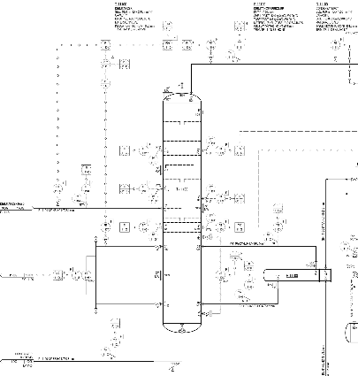
CCOM Contextualisation—Maintained by SDAIR
Asset
Debutanizer
Serial # DZR-3246
Each object uniquely identified by a UUID. Also refer back to the system of record.
Asset
Tower
Serial # T-456
Asset
Pipe Section
Asset
Condenser
Serial # CF332
Asset
Temp. Sensor
Serial # TS-999
Transducer
Model
Debutanizer
DZR 5000
Measurement Location
Temp. Loc. 1
Measurement
Recorded at:
2018-06-01:01:00
Measurement
Recorded at:
2018-06-01:01:00
Measurement
Recorded at:
2018-06-01:01:00
AssetSegmentEvent
Install
1 Jan 2018
AssetSegmentEvent
Install
1 Jan 2018
AssetSegmentEvent
Install
1 Jan 2018
AssetSegmentEvent
Install
1 Jan 2018
Measurement
10ºC at:
2018-06-01:01:00
Supports both Asset-
and Segment-based
MeasurementLocations
AttributeSet
Custom Measurement Data
Segment
Debutanizer Tower T100
Segment
Debutanizer Feed
Segment
Condenser C200
Segment
Temperature Sensor TS-1
Breakdown Structure
Primary
Segment
Temperature Sensor TS-2
Measurement Location
Temp. Loc. 2
Measurement
Recorded at:
2018-06-01:01:00
Measurement
Recorded at:
2018-06-01:01:00
Measurement
Recorded at:
2018-06-01:01:00
Measurement
4ºC at:
2018-06-01:01:00

Slide 111
CCOM Contextualisation—Configuration Change
Remove/Replace
Asset
Debutanizer
Serial # DZR-3246
Asset
Tower
Serial # T-456
Asset
Pipe Section
Asset
Condenser
Serial # CF332
Asset
Temp. Sensor
Serial # TS-999
Transducer
Asset
Pipe Section
Model
Debutanizer
DZR 5000
Measurement Location
Temp. Loc. 1
Measurement
Recorded at:
2018-06-01:01:00
Measurement
Recorded at:
2018-06-01:01:00
Measurement
Recorded at:
2018-06-01:01:00
AssetSegmentEvent
Install
1 Jan 2018
AssetSegmentEvent
Install
1 Jan 2018
AssetSegmentEvent
Install
1 Jan 2018
AssetSegmentEvent
Install
1 Jan 2018
Measurement
10ºC at:
2018-06-01:01:00
AssetSegmentEvent
Remove
2 Jan 2018
AssetSegmentEvent
Install
3 Jan 2018
Supports both Asset-
and Segment-based
MeasurementLocations
AttributeSet
Custom Measurement Data
Segment
Debutanizer Tower T100
Segment
Debutanizer Feed
Segment
Condenser C200
Segment
Temperature Sensor TS-1
Breakdown Structure
Primary
Segment
Temperature Sensor TS-2
Measurement Location
Temp. Loc. 2
Measurement
Recorded at:
2018-06-01:01:00
Measurement
Recorded at:
2018-06-01:01:00
Measurement
Recorded at:
2018-06-01:01:00
Measurement
4ºC at:
2018-06-01:01:00

Slide 112
Message Exchanges

Slide 113
(Web Service) Information Service Bus Model
Information Service Bus Model is the centre of messaging in the OIIE
Purpose: to facilitate interoperability by providing a standardized set of web services for the sending/receiving of messages via a bus—leads to application and supplier agnostic ecosystem administration
Supports publish/subscribe and request/response modalities
  Includes Notification web services: avoids polling the bus for messages
OpenO&M ws-ISBM specification v1.0 based on SOAP web services
Current SOAP API already RESTful: each request includes all information required
RESTful architectures are technically protocol and data format agnostic
Revised specification, v1.1, will support plain HTTP/JSON REST interface
  To be proven in the upcoming stage of the OGI pilot
  MQTT or AMQP

Slide 114
ws-ISBM REST API—Resources
ISBM is payload data agnostic
Resources are NOT payload data types such as MeasurementLocation
Resources in the ISBM include:
  Channels
  Security Tokens
  Sessions
  Messages
Revision 1.2 will consider configurable mappings for payload-based interfaces
  There are several potential challenges in developing such a mapping

Slide 115
ws-ISBM Channel Management Service
Service Operation | SOAP Interface | RESTful Interface
Create Channel | HTTP method: POST URL: /ChannelManagement Data: Specified in HTTP body | HTTP method: POST URL: /channels Data: Specified in HTTP body
Add Security Tokens | HTTP method: POST URL: /ChannelManagement Data: Specified in HTTP body | HTTP method: POST URL: /channels/{channel-id}/security-tokens Token data is specified in HTTP body
Remove Security Tokens | HTTP method: POST URL: /ChannelManagement Data: Specified in HTTP body | HTTP method: DELETE URL: /channels/{channel-id}/security-tokens/{token-id} Data: Specified in URL
Delete Channel | HTTP method: POST URL: /ChannelManagement Data: Specified in HTTP body | HTTP method: DELETE URL: /channels/{channel-id} Data: Specified in URL
Get Channel | HTTP method: POST URL: /ChannelManagement Data: Specified in HTTP body | HTTP method: GET URL: /channels/{channel-id} Data: Specified in URL
Get Channels | HTTP method: POST URL: /ChannelManagement Data: N/A | HTTP method: GET URL: /channels Data: N/A

Slide 116
ws-ISBM Consumer Request Service
Service Operation | SOAP Interface | RESTful Interface
Open Consumer Request Session | HTTP method: POST URL: /OpenConsumerRequestSession Data: Specified in HTTP body | HTTP method: POST URL: /channels/{channel-id}/consumer-request-sessions[?listenerUrl={URL}] Data: Specified in URL (channel-id, optional listenerUrl)
Post Request | HTTP method: POST URL: /PostRequest Data: Specified in HTTP body | HTTP method: POST URL: /sessions/{session-id}/requests?topic={string}[&expiry={duration}] Data: Message specified in HTTP body, filters in URL
Expire Request | HTTP method: POST URL: /ExpireRequest Data: Specified in HTTP body | HTTP method: DELETE URL: /sessions/{session-id}/requests/{message-id} Data: Specified in URL
Read Response | HTTP method: POST URL: /ReadResponse Data: Specified in HTTP body | HTTP method: GET URL: /sessions/{session-id}/responses?requestMessageId={string} Data: Specified in URL
Remove Response | HTTP method: POST URL: /RemoveResponse Data: Specified in HTTP body | HTTP method: DELETE URL: /sessions/{session-id}/responses/{response-message-id} Data: Specified in URL
Close Consumer Request Session | HTTP method: POST URL: /CloseConsumerRequestSession Data: Specified in HTTP body | HTTP method: DELETE URL: /sessions/{session-id} Data: Specified in URL

Slide 117
ws-ISBM Provider Request Service
Service Operation | SOAP Interface | RESTful Interface
Open Provider Request Session | HTTP method: POST URL: /OpenProviderRequestSession Data: Specified in HTTP body | HTTP method: POST URL: /channels/{channel-id}/provider-request-sessions Data: Session config specified in HTTP body (topics[1..*], listener-url[?], XPathExpression[0..1], XPathNamespace[*])
Read Request | HTTP method: POST URL: /ReadRequest Data: Specified in HTTP body | HTTP method: GET URL: /sessions/{session-id}/request Data: Specified in URL
Remove Request | HTTP method: POST URL: /RemoveRequest Data: Specified in HTTP body | HTTP method: DELETE URL: /sessions/{session-id}/request Data: Specified in URL
Post Response | HTTP method: POST URL: /PostResponse Data: Specified in HTTP body | HTTP method: POST URL: /sessions/{session-id}/responses?requestMessageId={string} Data: Message specified in HTTP body, filters in URL
Close Provider Request Session | HTTP method: POST URL: /CloseProviderRequestSession Data: Specified in HTTP body | HTTP method: DELETE URL: /sessions/{session-id} Data: Specified in URL

Slide 118
OIIE Use Case Message Requirements
Response messages must include contextual parameters to support:
  Redistribution
  Load balancing
  Archival
  Analytics
Standardized application level status (errors, etc.)
  Through appropriate CCOM reference data
Extensible application level status:
  Different providers/systems may have their own error codes that need to be describable, exchangeable, and interpretable
  Through vendor reference data, for example

Slide 119
OIIE Use Case Message Structure
Utilise the BOD architecture
  Fulfils most requirements out-of-the-box
  Extensibility allows support for the rest
Supported Verbs
  Get, Show, Sync, Confirm
Specify additional header properties in the Application Area as required
  For example, Show including the original filters from the Get message.
  User Area is preferred for meta-data, rather than modifying the Data Area
Business Object Document
Application Area
Data Area
Verb
Noun
MIMOSA CCOM Payload

Slide 120
Example Publish Configuration Change (Remove): Scenario 10
Asset
Debutanizer
Serial # DZR-3246
POST: /sessions/{session-id}/publications?topic={topic-name}
SyncAssetSegmentEvents
Asset
Tower
Serial # T-456
Asset
Pipe Section
Asset
Condenser
Serial # CF332
Asset
Temp. Sensor
Serial # TS-999
Transducer
Model
Debutanizer
DZR 5000
"dataArea": { "sync": {},
"assetSegmentEvents": [ {
"assetSegmentEvent": [ {
"@@type": "AssetSegmentEvent",
"UUID": "3a79dbc5-4801-8fd7-8645-2de5faef4780",
"ShortName": "Flow Meter S/N TS-189 Removed on FM-8",
"Created": "2018-10-01T03:28:20Z",
"Start": "2018-10-01T03:40:20Z",
"End": "2018-10-01T03:28:40Z",
"InfoSource": { "UUID": "19a137cf-a70d-2888-343a-bc1158bf7f9f" },
"EventType": {
"UUID": "3a45e126-b234-42a0-b3b1-07c29522d02d",
"ShortName": "Removal of Asset on Segment",
"InfoSource": { "UUID": "cf3f3a8a-1e42-4f15-9288-9cf2241e163d" }
},
"Asset": {
"UUID": "35e17dde-6e82-4591-50a3-f553b6185292",
"ShortName": "Flow Meter FM-189"
},
"Segment": {
"UUID": "ec5a2f64-1c3a-34ef-766d-eb69ba865d59",
"ShortName": "Flow Meter FM-8"
}
} ] } ] }
Measurement Location
Temp. Loc. 1
Measurement
Recorded at:
2018-06-01:01:00
Measurement
Recorded at:
2018-06-01:01:00
Measurement
Recorded at:
2018-06-01:01:00
AssetSegmentEvent
Install
1 Jan 2018
AssetSegmentEvent
Install
1 Jan 2018
AssetSegmentEvent
Install
1 Jan 2018
AssetSegmentEvent
Install
1 Jan 2018
Measurement
10ºC at:
2018-06-01:01:00
Supports both Asset-
and Segment-based
MeasurementLocations
AttributeSet
Custom Measurement Data
Segment
Debutanizer Tower T100
Segment
Debutanizer Feed
Segment
Condenser C200
Segment
Temperature Sensor TS-1
Breakdown Structure
Primary
Segment
Temperature Sensor TS-2
Measurement Location
Temp. Loc. 2
Measurement
Recorded at:
2018-06-01:01:00
Measurement
Recorded at:
2018-06-01:01:00
Measurement
Recorded at:
2018-06-01:01:00
Measurement
4ºC at:
2018-06-01:01:00

Slide 121
Example Query for Context/Configuration: Scenario 11
Asset
Debutanizer
Serial # DZR-3246
POST: /sessions/{session-id}/requests?topic={topic-name}
GetAssetSegmentEvents
Asset
Tower
Serial # T-456
Asset
Pipe Section
Asset
Condenser
Serial # CF332
Asset
Temp. Sensor
Serial # TS-999
Transducer
Model
Debutanizer
DZR 5000
Measurement Location
Temp. Loc. 1
Measurement
Recorded at:
2018-06-01:01:00
Measurement
Recorded at:
2018-06-01:01:00
Measurement
Recorded at:
2018-06-01:01:00
AssetSegmentEvent
Install
1 Jan 2018
AssetSegmentEvent
Install
1 Jan 2018
AssetSegmentEvent
Install
1 Jan 2018
AssetSegmentEvent
Install
1 Jan 2018
Measurement
10ºC at:
2018-06-01:01:00
{
"@@type": "GetAssetSegmentEvents", "@releaseID": "9.0", "@versionID": "1.0",
"applicationArea": {
"sender": {
"logicalId": "466aa22b-ffce-4ea0-acf4-587e372d7ba5"
},
"creationDateTime": "2018-10-22T08:34:15Z",
"bodID": "0e4bd242-77b6-476c-9105-c63fc078b595"
},
"dataArea": {
"get": {},
"assetSegmentEventsCriteria": [
{
"segmentUuid": { "value": "ec5a2f64-1c3a-34ef-766d-eb69ba865d59" }
}
]
}
}
Supports both Asset-
and Segment-based
MeasurementLocations
AttributeSet
Custom Measurement Data
Segment
Debutanizer Tower T100
Segment
Debutanizer Feed
Segment
Condenser C200
Segment
Temperature Sensor TS-1
Breakdown Structure
Primary
Segment
Temperature Sensor TS-2
Measurement Location
Temp. Loc. 2
Measurement
Recorded at:
2018-06-01:01:00
Measurement
Recorded at:
2018-06-01:01:00
Measurement
Recorded at:
2018-06-01:01:00
Measurement
4ºC at:
2018-06-01:01:00

Slide 122
Example Query for Context/Configuration: Scenario 11
GET: /sessions/{session-id}/responses?requestMessageId=0e4bd242-…-c63fc078b595
GetAssetSegmentEvents
Asset
Debutanizer
Serial # DZR-3246
{ "dataArea": { "show": {},
"assetSegmentEvents": {
"count": 2,
"assetSegmentEvent": [
{
"@@type": "AssetSegmentEvent",
"UUID": "3a79dbc5-4801-8fd7-8645-2de5faef4780",
"ShortName": "Flow Meter S/N TS-189 Removed on FM-8",
"Created": "2018-10-01T03:28:20Z",
"Start": "2018-10-01T03:40:20Z",
"End": "2018-10-01T03:28:40Z",
"InfoSource": { "UUID": "19a137cf-a70d-2888-343a-bc1158bf7f9f" },
"EventType": {
"UUID": "3a45e126-b234-42a0-b3b1-07c29522d02d",
"ShortName": "Removal of Asset on Segment",
"InfoSource": { "UUID": "cf3f3a8a-1e42-4f15-9288-9cf2241e163d" }
},
"Asset": {
"UUID": "35e17dde-6e82-4591-50a3-f553b6185292",
"ShortName": "Flow Meter FM-189"
},
"Segment": {
"UUID": "ec5a2f64-1c3a-34ef-766d-eb69ba865d59",
"ShortName": "Flow Meter FM-8"
}
},
{ … }
] } } }
Asset
Tower
Serial # T-456
Asset
Pipe Section
Asset
Condenser
Serial # CF332
Asset
Temp. Sensor
Serial # TS-999
Transducer
Model
Debutanizer
DZR 5000
Measurement Location
Temp. Loc. 1
Measurement
Recorded at:
2018-06-01:01:00
Measurement
Recorded at:
2018-06-01:01:00
Measurement
Recorded at:
2018-06-01:01:00
AssetSegmentEvent
Install
1 Jan 2018
AssetSegmentEvent
Install
1 Jan 2018
AssetSegmentEvent
Install
1 Jan 2018
AssetSegmentEvent
Install
1 Jan 2018
Measurement
10ºC at:
2018-06-01:01:00
Supports both Asset-
and Segment-based
MeasurementLocations
AttributeSet
Custom Measurement Data
Segment
Debutanizer Tower T100
Segment
Debutanizer Feed
Segment
Condenser C200
Segment
Temperature Sensor TS-1
Breakdown Structure
Primary
Segment
Temperature Sensor TS-2
Measurement Location
Temp. Loc. 2
Measurement
Recorded at:
2018-06-01:01:00
Measurement
Recorded at:
2018-06-01:01:00
Measurement
Recorded at:
2018-06-01:01:00
Measurement
4ºC at:
2018-06-01:01:00

Slide 123
Push (Current) Condition/Operation Information: Scenarios 29/30
Asset
Debutanizer
Serial # DZR-3246
Asset
Tower
Serial # T-456
Asset
Pipe Section
Asset
Condenser
Serial # CF332
Asset
Temp. Sensor
Serial # TS-999
Transducer
Model
Debutanizer
DZR 5000
Measurement Location
Temp. Loc. 1
Measurement
Recorded at:
2018-06-01:01:00
Measurement
Recorded at:
2018-06-01:01:00
Measurement
Recorded at:
2018-06-01:01:00
AssetSegmentEvent
Install
1 Jan 2018
AssetSegmentEvent
Install
1 Jan 2018
AssetSegmentEvent
Install
1 Jan 2018
AssetSegmentEvent
Install
1 Jan 2018
Measurement
10ºC at:
2018-06-01:01:00
Supports both Asset-
and Segment-based
MeasurementLocations
POST: /sessions/{session-id}/publications?topic={topic-name}
SyncMeasurements [including MeasurementLocation context]
GET: /sessions/{session-id}/publication
SyncMeasurements
AttributeSet
Custom Measurement Data
Segment
Debutanizer Tower T100
Segment
Debutanizer Feed
Segment
Condenser C200
Segment
Temperature Sensor TS-1
Breakdown Structure
Primary
Segment
Temperature Sensor TS-2
Measurement Location
Temp. Loc. 2
Measurement
Recorded at:
2018-06-01:01:00
Measurement
Recorded at:
2018-06-01:01:00
Measurement
Recorded at:
2018-06-01:01:00
Measurement
4ºC at:
2018-06-01:01:00

Slide 124
Get (Historical) Condition/Operation Information: Scenarios 31/32
POST: /sessions/{session-id}/requests?topic={topic-name}
GetMeasurementLocations[filtered by Asset UUID]
GET: /sessions/{session-id}/responses?requestMessageId={id}
ShowMeasurementLocations
Asset
Debutanizer
Serial # DZR-3246
Asset
Tower
Serial # T-456
Asset
Pipe Section
Asset
Condenser
Serial # CF332
Asset
Temp. Sensor
Serial # TS-999
Transducer
Model
Debutanizer
DZR 5000
Measurement Location
Temp. Loc. 1
Measurement
Recorded at:
2018-06-01:01:00
Measurement
Recorded at:
2018-06-01:01:00
Measurement
Recorded at:
2018-06-01:01:00
AssetSegmentEvent
Install
1 Jan 2018
AssetSegmentEvent
Install
1 Jan 2018
AssetSegmentEvent
Install
1 Jan 2018
AssetSegmentEvent
Install
1 Jan 2018
Measurement
10ºC at:
2018-06-01:01:00
Supports both Asset-
and Segment-based
MeasurementLocations
POST: /sessions/{session-id}/requests?topic={topic-name}
GetMeasurements[filtered by MeasurementLocation UUID & date/time]
GET: /sessions/{session-id}/responses?requestMessageId={id}
ShowMeasurements
AttributeSet
Custom Measurement Data
Segment
Debutanizer Tower T100
Segment
Debutanizer Feed
Segment
Condenser C200
Segment
Temperature Sensor TS-1
Breakdown Structure
Primary
Segment
Temperature Sensor TS-2
Measurement Location
Temp. Loc. 2
Could also be filtered by Asset or Segment.
Measurement
Recorded at:
2018-06-01:01:00
Measurement
Recorded at:
2018-06-01:01:00
Measurement
Recorded at:
2018-06-01:01:00
Measurement
4ºC at:
2018-06-01:01:00

Slide 125
Collaboration Update

Slide 126




Solution: Open Standards Fill The Gaps
Enterprise Business Systems
Enterprise Resource Planning (ERP)
OpenO&M™
OPERATIONS
MAINTENANCE
Physical Asset Control
Real-time Systems
Notes:
Rather than using proprietary, point-to-point interfaces to integrate the large number of military platforms and their associated technical applications with each other and the SAP Enterprise Resource Planning (ARP) applications, MIMOSA Open Standards provide a standards-based abstraction and integration layer. SAP NetWeaver can leverage the MIMOSA standards with a wide range of Technical Applications providing logistics integration between the true real-time platform control environment and the transaction processing ERP environment. Adoption of Non-proprietary, Open Standards such as MIMOSA will enable cost effective transition management for many different technical applications and military platforms as they must change over time in the transformational military services.

Slide 127

OpenO&M Joint Working Group – Current Activities
ISBM Update in alignment with ISA 95/IEC 62264 MSM
Version 1.0 being updated to Version 1.x
OIIE Use Cases Provide Functional and Non-Functional Requirements
OpenO&M Website
Functional Requirements
Channel Management
Service API
Message support for
IIoT sensor data
Process support (e.g., BPEL)
Non-Functional Requirements
Performance
Easy Administration
Scalability
Supplier Neutrality
Reliability
Security (e.g., ISA99)
Intra-/Inter-Enterprise comm.
Implementation Requirements
Publish/Subscribe vs Request/Response
REST vs SOAP
Support for XML and JSON
OpenAPI
MQTT

Slide 128
Proper evaluation of requirements from IIoT perspective necessary
Each requirement is evaluated against OIIE Use Cases
  Examples: XML vs JSON and OpenAPI
XML vs JSON
Large differences between XML Schema and JSON Schema definition
Required for verification
Challenges if support for both at the same time
OpenAPI
Proposal for JSON and XML schema in an OpenAPI document (not yet accepted)
Current OpenAPI refers to early JSON Schema version

Slide 129
MIMOSA/OIIE Documentation Strategy
MIMOSA Website (http://www.mimosa.org/)
- General Description of Initiatives
- Downloads of versioned releases of documents and specifications
- Current Documents as HTML pages
- Current Examples as HTML pages
MS Teams Environment
- Members only discussion of in progress specifications
- Open discussion on joint initiatives, e.g., OpenO&M
GitHub (members only)
- Version controlled source documents and specifications
- Issue tracking
- Summary of discussion and rationale based on outcome of discussion in MS Teams

Slide 130

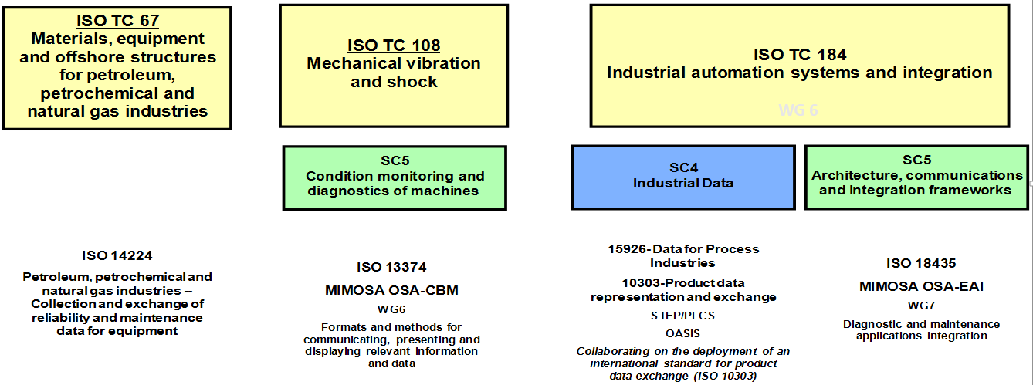
  Many related ISO and IEC Activities
WG 6

Slide 131
ISO 18101-1 Concept Map
Being Developed By ISO TC 184/WG 6
CD/DTS Ballot Completed (12 Yes Votes)
Reference
Environment
Interoperability
Execution
Environment
Digital Transformation
Capital
Project
Supplier Neutral
O&M
IEC 62264 MSM/OpenO&M ISBM
Shared Semantic Context
Digital Twin/Event/Time Series
Data Sets
Validated
Use Cases
OGI Pilot
Information and Data Quality
ISO 8000

Slide 132
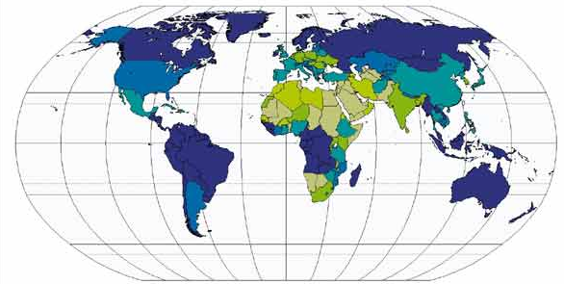
Global Collaboration
Asset Institute
NIST (Smart Manufacturing Team for Industry 4.0)
POSC Caesar, USPI

