Slide 1
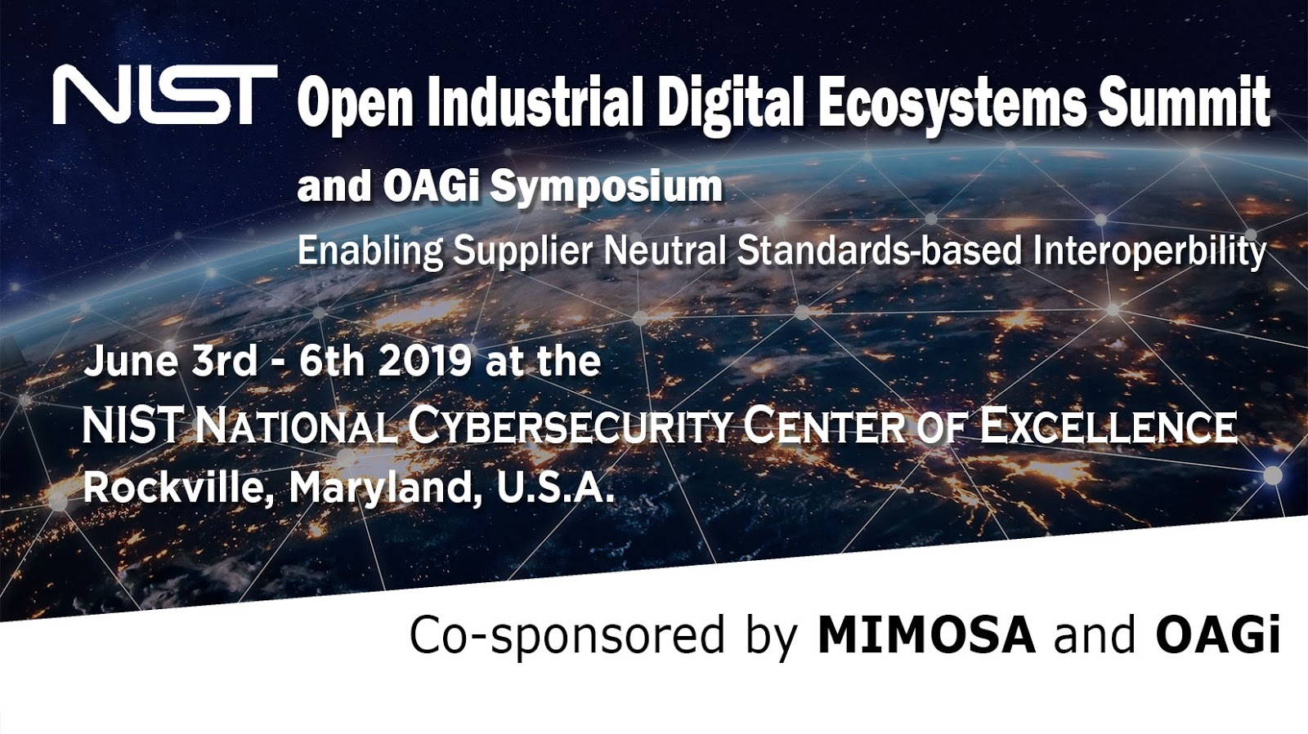

Slide 2
NIST Open Industrial Ecosystem Summit
OAGi and MIMOSA Cooperation Supporting the Open Industrial Interoperability Ecosystem (OIIE)
Summary
June 3, 2019
Alan T. Johnston
MIMOSA President

Slide 3

Process Industry Smart Manufacturing and Asset Life-cycle Management
Using Standards Based Interoperability and the OIIE
Operations and Life-cycle Asset Management Processes
PERA
Trusted S ystems
IIOT Sensors
Analytics at all Levels
$
Enterprise
Management
Models
OAGi Focus
L4
ERP Process Models
Supply Chain Integration
MOM Processes-Joint Collaboration
OpenO&M, IEC, ISO
L3
Equipment Models
MIMOSA Focus
Components Models
L2
Device Models
System Models
Sensor Models
Industrial Process Models
Interoperability Ecosystem Management
L1
Notes:
Process industry owner/operators wish to move from a systems integration paradigm to a Standards Based Interoperability (SBI) paradigm, where products (devices, equipment, software and systems) interoperate with each other in a system of systems model for standard use cases and scenarios which can be validated in a testbed like the OGI Pilot. In this situation, standards conformant adaptors are produced, licensed and supported by the product manufacturers (preferred) and/or 3rd parties. As the SBI paradigm is being developed and deployed, more efficient Agile Integration will be a gap filler.
Score tool has produced a significant impact to OAGi members such as Lockheed and Land O’Lakes in reducing time to produce integration artifacts. This slide depicts pre-existing collaborations in the MOM level of the PERA, including B2MML, ISA, MIMOSA, OAGi and OPC) as well as 2 new collaborations. The first was between NIST and OAGi and the second is between NIST and MIMOSA. This combination of collaborations in support of owner/operators such as Land O’ Lakes offers renewed opportunities for increasing efficiencies in Process Industries, Discreet Manufacturers and overall Critical Infrastructure Management.

Slide 4


OIIE OGI Pilot Phase 3.1 Activities 1-4 (Use Cases)
Debutanizer Tower Condenser Unit P&ID
Worley Parsons, Fluor
Bentley (CCOM XML)
P&ID Logical Connection information
MIMOSA Structured Digital Asset Interoperability Registry
RFI/RFI Response (Greenfield)
RFI Response – Models
RFI – Functional requirements
Capital Project Asset Installation
Request for Model properties (ISDDs)
Asset instances selected from RFI Response (defined using ISDDs)
Installed on P&ID Tag locations (defined using ISDDs)
Aveva, Hexagon (Proteus XML)
Procure
With OAGi
EPC
OEM
Adding Detail to Prior Work
As-Designed O&M Takeoff using CCOM or Proteus
Use Cases ISDD Based Way of Specifying, Selecting and Buying Devices and Equipment
Use Case
Adding As-Built Information Using OIIE Events

Slide 5


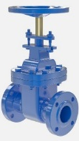
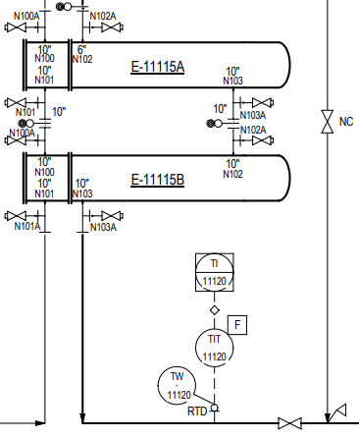
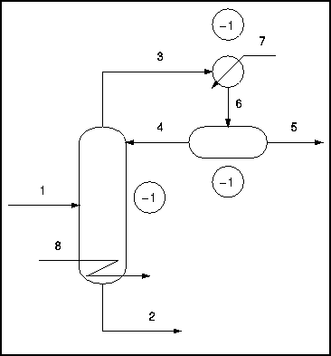
Critical Infrastructure Risk Management
Critical Infrastructure Risk Management Process
NIST is working with MIMOSA on Interoperability for IIOT and Critical Infrastructure Risk Management Standardization.
MIMOSA CCOM can model the industrial processes, systems, components and risks as well as the sensor-based information. This includes ALL Risks which can be identified and modeled, including but not limited to cyber risks.
NIST Summit – June 3-4
$
Trusted Systems
IIOT Sensors
Analytics &
Risk Models
Reliability
Management
Business Process Models
Components Models
Systems Models
Industrial Process Models
Notes:
This shows the logical order in which the modeling is done in a process manufacturing environment. The Process Models (PFDs) are done first, followed by the Systems Models (P&IDs) and instances of Components Models are added when construction pairs components with locations defined in the Systems Models (P&ID Tags). Business Process Models sit on top of these models, using them for business purposes. The sensor-based data flows are then contextualized by all of the models, enabling analytics to be done with improved accuracy and efficiency. Risk Models can then sit on top of all of the other models, leveraging them, sensor based information and alarms/events flowing from all systems in the system of systems.

Slide 6
Critical Infrastructure Sectors – From US PPD 21-2013
Chemical
Commercial facilities
Communications
Critical manufacturing
Dams
Defense industrial base
Emergency services
Energy
Financial services (including insurance)
Food and agriculture
Government facilities
Healthcare and public health
Information technology
Nuclear reactors, materials, and waste
Transportation systems
Water and wastewater systems
The Sectors identified with arrowheads are asset intensive and share many engineering, IT and management practices as well as equipment and device classes where it is possible to standardize methods to Model, Monitor and Manage Processes, Systems and Components as well as ALL Associated Risks.

Slide 7
Cross Sector Smart Manufacturing and Critical Infrastructure Risk Management
Using Standards Based Interoperability and the OIIE
Critical Infrastructure Risk Management Processes
PERA
Trusted S ystems
IIOT Sensors
Analytics at all Levels
$
Risk Models
OAGi Focus
L4
ERP Process Models
Supply Chain Integration
MOM Processes-Joint Collaboration
OpenO&M, IEC, ISO
L3
Equipment Models
MIMOSA Focus
Components Models
L2
Device Models
System Models
Sensor Models
Industrial Process Models
Interoperability Ecosystem Management
L1
Notes:
Process industry owner/operators wish to move from a systems integration paradigm to a Standards Based Interoperability (SBI) paradigm, where products (devices, equipment, software and systems) interoperate with each other in a system of systems model for standard use cases and scenarios which can be validated in a testbed like the OGI Pilot. In this situation, standards conformant adaptors are produced, licensed and supported by the product manufacturers (preferred) and/or 3rd parties. As the SBI paradigm is being developed and deployed, more efficient Agile Integration will be a gap filler.
Score tool has produced a significant impact to OAGi members such as Lockheed and Land O’Lakes in reducing time to produce integration artifacts. This slide depicts pre-existing collaborations in the MOM level of the PERA, including B2MML, ISA, MIMOSA, OAGi and OPC) as well as 2 new collaborations. The first was between NIST and OAGi and the second is between NIST and MIMOSA. This combination of collaborations in support of owner/operators such as Land O’ Lakes offers renewed opportunities for increasing efficiencies in Process Industries, Discreet Manufacturers and overall Critical Infrastructure Management.

Slide 8
Transforming the Oil and Gas Industry Using the OIIE
A Pragmatic Solution for Industrial Digitalization
Open
Industrial Digital
Ecosystem
Open Industrial Digital Ecosystem (OIIE)
ISO 18101
Custom
Integration
Industry Standard Digital Ecosystem
Supplier neutral – open source and COTS
Standard shared set of standards
Standard use case architecture
Standard use cases, scenarios & events
Standard APIs and services definitions
Standard information payloads
Standard adaptors
Standard reference data - ISDDs
Standard ecosystem administration
Standard piloting testbed
Custom development
Specific data adapters
Owner/operator responsible for sustainment
High Development and Sustainment Costs
Inflexible and Fragile
High Risk/Vulnerable
No practical basis for industry transformation
Defined by supplier-neutral standards
Lower switching costs, reduces supplier lock-in and large supplier control
Enables innovation from SMEs
Configuration rather than development
Suppliers build and maintain standard adaptors with commercial support model
Higher quality with lower costs and risks
Adaptable and Evolutionary
Practical Basis for industry transformation

Slide 9




OpenO&M Initiative – Formed 2004
Enterprise Business Systems
Enterprise Resource Planning (ERP)
Level R4
OpenO&M™
OPERATIONS
MAINTENANCE
Level R3
Level R2
Physical Asset Control
Real-time Systems
Level R1
Level R0
Notes:
Rather than using proprietary, point-to-point interfaces to integrate the large number of military platforms and their associated technical applications with each other and the SAP Enterprise Resource Planning (ARP) applications, MIMOSA Open Standards provide a standards-based abstraction and integration layer. SAP NetWeaver can leverage the MIMOSA standards with a wide range of Technical Applications providing logistics integration between the true real-time platform control environment and the transaction processing ERP environment. Adoption of Non-proprietary, Open Standards such as MIMOSA will enable cost effective transition management for many different technical applications and military platforms as they must change over time in the transformational military services.

Slide 10
Level R4
ISA-95/IEC 62264 define an Operations Management Reference Architecture based on the Purdue Reference Architecture.
Primary business process:
Secondary business process:
Establish and Maintain Operations Capability
Level R3
P2B Stack:
Automation ERP
system
Production
Operations
Level R2
The OpenO&M Initiative, led by MIMOSA, extended the architecture to fully address life-cycle asset management in conjunction with Construction Industry Institute (CII). Collectively, this provides the basis for the Open Industrial Interoperability Ecosystem (OIIE) and ISO 18101 (ISO OGI TS).
Level R1
Level R0
Notes:
This Figure and the following ones through Systems Connectivity and Services Architecture are all shared between the OIIE and ISO 18101, since ISO 18101 is based on the OIIE. The Secondary Business Process is broadly agreed to be an optimal target for cross-industry standardization. The OIIE can also incorporate the primary business process for some industry groups (particularly process industries and their production supply chains). We currently include cooperation with ISA, OAGi and MESA B2MML for these purposes, which is part of why the OpenO&M Initiative was founded.

Slide 11
Full Asset Life-cycle Management
Completion,
Commission and Startup
Continuous Improvement Feedback Loops
Product
Design
Product
MFG
Process
Engineer
Simulate
Engineer
Design
Procure
Construct
Operate & Maintain (O&M)
End of Life
Device/Equip
Manufacturing
Platform Integrator
Capital Project
Owner/Operators
Product Model/Product=Component/Systems(Packages)/System of Systems/Plant/Facility/Platform Life-Cycles
Derived from ISO TC 184
Manufacturing Asset Management Integration Task Force Final Report
Notes:
This Figure was simplified and derived from the top-level summarizing Figure produced in the ISO TC 184 Manufacturing Asset Management Task Force, which identified the need and opportunity for ISO 18101.

Slide 12



OIIE/OGI Standardized Use Case Architecture
Standardized Methodology to Define and Re-use OIIE Components
Use
Cases
Scenarios
Events
Background
Actors
Individual Message Exchange
Scope
Preconditions
Successful End
Condition
Data Content
Data Formats
Reference Data
(OIIE) Events
Information Service
Bus Configuration
Specific Data Content
Implemented by CCOM BODS and possibly others
Required data processing
Expected Response Event
  Actors
  Triggers
  Process Workflows
  Scenarios
User Stories
High-level
Pictographic
Depict 1 or more Use Cases, Scenarios, and/or Events
Actors, Systems, Exchanges, Data
User Stories

Slide 13
OIIE Standard Use Case List
Derived from OpenO&M Standard Use Case List – Circa 2007
OIIE Use Case 1 – Information Handover from EPC to O/O
OIIE Use Case 2 – Engineering Updates
OIIE Use Case 3 – Field Changes to Plant/Facility Engineering
OIIE Use Case 4 – Online Product Data Library Management
OIIE Use Case 5 – Asset Installation/Removal Updates
OIIE Use Case 6 – Preventive Maintenance Triggering
OIIE Use Case 7 – Condition-Based Maintenance Triggering
OIIE Use Case 8 – Early Warning Notifications
OIIE Use Case 9 – Incident Management/Accountability
OIIE Use Case 10 – Information Provisioning of O&M Systems
OIIE Use Case 11 – Enterprise Reference Data Library Management
OIIE Use Case 12 – RFI and RFI Response for Models Meeting Requirements (Greenfield & Brownfield)
OIIE Use Case 13 – Lockout-Tagout
OIIE Use Case 14 – Condition-Based Maintenance Data Acquisition
OIIE Use Case 15 – Capital Project Asset Installation
Current OIIE Use Cases Focus on Life-cycle Asset Management and OIIE Administration
May be expanded into more of Operations Management in conjunction with UWA/Kirkman
Notes:
The use cases in bold face are in the identified scope of the current OIIE OGI Pilot phase.

Slide 14
OIIE Inter-Enterprise Systems Connectivity and Services Architecture
Enabling Industry 4.0
EPC Firms
Engineering , Procurement and Construction
IT Networks
Functional and Technical Requirements
Business Requirements
OEMs
Manufacturers
PFD, P&ID, Tags, Docs
& Requirements
Owner/Operators
Model and Instance Information
Enterprise Business Systems
Enterprise Business Systems
IT Networks
IT Networks
Manufactured Asset Data
(Make/Model Information, Serial #)
Operations & Maintenance Data
(Monitoring, Diagnostics Prognostics)
Automation and Control
Automation and Control

Slide 15
OIIE Intra-Enterprise Systems Connectivity and Services Architecture
Enterprise Business Systems
OIIE Administration
Planning
Engineering Design
Construction Management
Operations Management
Operations Risk Management
Maintenance Management
IEC 62264 Messaging Service Model /OpenO&M Information Service Bus Model
Standard, Cloud Friendly Enterprise Solutions Architecture For Digital Business Ecosystems
Trusted
Systems
Inter-Enterprise Connections
Automation and Control
HSE and Operation Monitoring
Prognostic & Health Management
Connectivity Legend
Automation Control Bus
IIoT Connections
IIOT Device
(Constrained)
Device
Device
Sensor/ Transducer
Trusted IT/OT connections
ISBM Web Services
(Constrained)
Shared Information and Semantic Context
Enterprise Reference Data Libraries
IIoT Device Metadata
Industry Reference Data Libraries
IIoT Device Metadata
(ISO 15926, OTD, CDD…)

Slide 16
  Many related ISO and IEC Activities
WG 6 – ISO 18101: OGI TS
Digitalization & Interoperability

Slide 17
ISO 13374 Standard
Machine Condition Assessment Data Processing & Information Flow Blocks

Slide 18
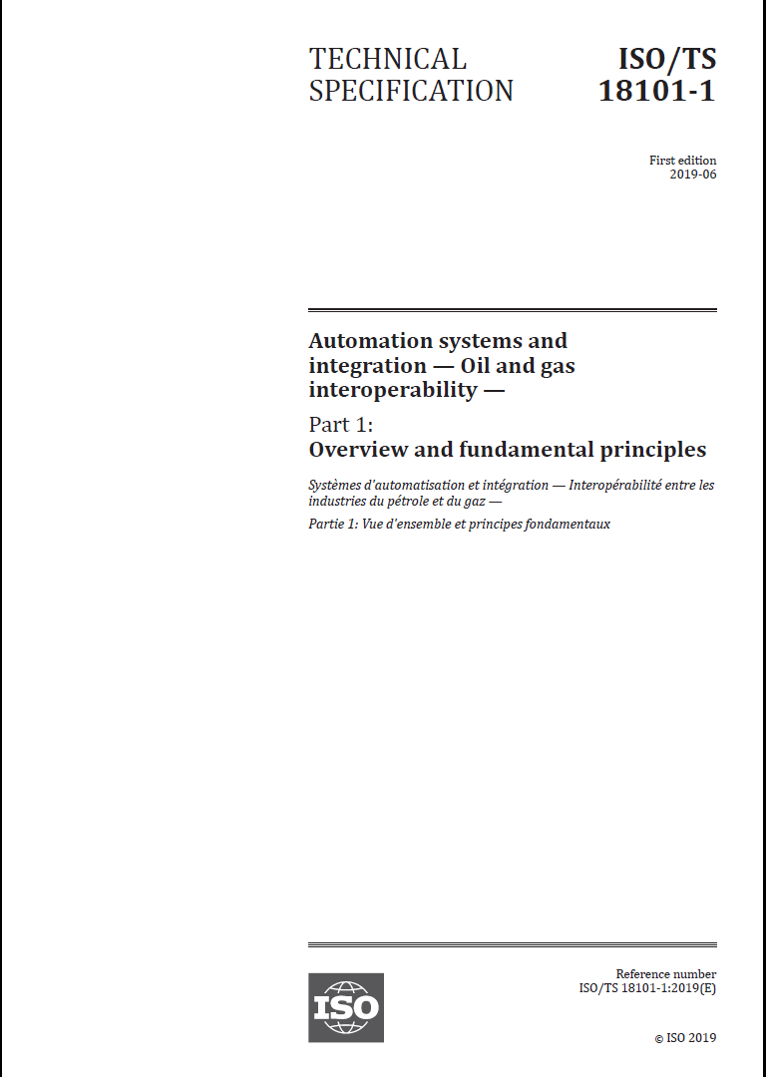
Notes:
This is the final proof copy of ISO TS 18101-1 (Oil and Gas Interoperability) – The Scope includes the language above, specifically linking it to the OIIE and the OIIE OGI Pilot. Publication is scheduled for June.

Slide 19
ISO TS 18101-1 Foreword
Paragraph 6
“This document was prepared by Technical Committee ISO/TC 184, Automation systems and integration.
This document provides an overview and outlines the fundamental principles of the ISO 18101 series. Future parts of the ISO 18101 series will be developed including sets of industry developed use cases, once the use cases have been documented using the Open Industrial Interoperability Ecosystem (OIIE) use case architecture and validated using the OIIE Oil and Gas Interoperability (OGI) Pilot, with the results captured in Technical Reports. These use cases will incrementally define industry prioritized elements of the secondary business process, which is the scope of the ISO 18101 series.”
Notes:
This is the final proof copy of ISO TS 18101-1 (Oil and Gas Interoperability) – The Scope includes the language above, specifically linking it to the OIIE and the OIIE OGI Pilot. Publication is scheduled for June.

Slide 20
OIIE Oil and Gas Interoperability (OGI) Pilot
Sub-phase 3.1

Slide 21
OIIE OGI Pilot Phase 3.1 Activities 1-4 (Use Cases)
Debutanizer Tower Condenser Unit P&ID
Worley Parsons, Fluor
Bentley (CCOM XML)
P&ID Logical Connection information
MIMOSA Structured Digital Asset Interoperability Registry
RFI/RFI Response (Greenfield)
RFI Response – Models
RFI – Functional requirements
Capital Project Asset Installation
Request for Model properties (ISDDs)
Asset instances selected from RFI Response (defined using ISDDs)
Installed on P&ID Tag locations (defined using ISDDs)
Aveva, Hexagon (Proteus XML)
Procure
With OAGi
EPC
OEM
Adding Detail to Prior Work
As-Designed O&M Takeoff using CCOM or Proteus
OIIE Use Case 12; ISDD Based Way of Specifying, Selecting and Buying Devices and Equipment
OIIE Use Case 15:
Adding As-Built Information Using OIIE Events
Notes:
This is a simplified storyboard for the use cases included in the current pilot 3.1 sub-phase. It follows what is often called the “main digital thread” for a capital project, extended through Operations and Maintenance to end of life, with focus in key areas being updated based on gap analysis from prior pilot phases.

Slide 22


OIIE OGI Pilot Phase 3.1 Activities 5-8 (Use Cases)
Information Handover
From Capital Project to Operations and Maintenance
Condition Based Maintenance
Remove and Replace
Diagnostics
RFI/RFI Response (Brownfield)
Information Remediation
Over ISBM (Information Service Bus Model)
Prognostics
Advisory Generation
OIIE Use Case 1 Simulated
OIIE Use Case(s) 7, and 14
OIIE Use Case 5
OIIE Use Case 12
Notes:
The focus here is on CBM and associated interactions with an EAM/CMMS system, (which in this case will be SAP PM, but could be any such system). The Brownfield Information Remediation Use Case is very important and shows the ability to re-use standard Scenarios and Events across the entire lifecycle.

