Slide 1
Standardising Standards-based Interoperability:
The Architecture of the OIIE and OGI Pilot
Matt Selway and Markus Stumptner (Co-CTO MIMOSA)
University of South Australia
June 4, 2019
NIST Open Industrial Digital Ecosystem Summit

Slide 2

AI and Software Engineering Group
About 20 people
AI + Software Engineering + Data Management
Major topics
  Modelling and reasoning about system behaviour
  Diagnostics, Configuration, Automated Debugging, Natural Language
  Information and knowledge management in distributed ecosystems

Slide 3

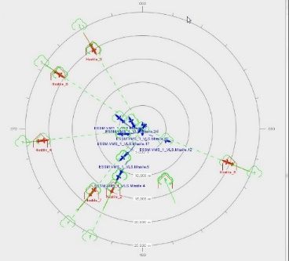









Projects in the Ecosystem Space
OT/IT Interoperability
Digital Information Energy Australia
Gateway
OGI Pilot - OIIE
Genetic Data Curation
SOA for Future Combat Systems
Automated Modelling for Combat Simulation Ecosystems
Integrated Law Enforcement –
Federated Data Platform

Slide 4
What is the OIIE?
Open Industrial Interoperability Ecosystem
Framework and architecture for defining and describing standardised and standards-based ways for how systems should interoperate
Aims to support Digitalization, Supplier-neutral, and enable COTS & Open Source Plug ‘n Play Interoperability
Refinement of concepts MIMOSA has been developing for ~15 years
Includes several components:
  Use Case Architecture
  Connectivity and Services Architecture
  Data and Message Models
  Specifications for systems supporting Ecosystem Administration, e.g:
    ws-ISBM, SDAIR, CIR, Services Registry

Slide 5
Supplier Neutral Industrial Digital Ecosystem
Digital Ecosystem Concept Specialized For Process Industries
Enterprise Ecosystem Nodes
Com-ponents
Systems
Network of Enterprise Ecosystems
EPC
Ecosystem
Owner
Operator
Ecosystem
Interoperating Enterprise Digital Ecosystems
Supplier Neutral
Industrial Digital Ecosystem
OEM
Ecosystem
Systems
Com-ponents
Major suppliers of IT Infrastructure and Industrial Applications and Systems all want their ecosystem to be THE Ecosystem.

Slide 6
What is the OGI Pilot?
Test-bed and proving ground for the OIIE
Where we try to make the OIIE a reality
Previous pilots phases focused on EPC→O&M Handover of As-Designed Engineering Data (P&IDs, etc.)
Current pilot phase covers 2 additional major aspects:
  Requests for model information relating to requirements (greenfield) and/or incomplete asset data (brownfield)
  Condition-based Maintenance
Possible areas for future pilot phases:
  Coverage of process design (PFDs)
  Expand Capital Projects Use Cases, full Procurement
  CBO (Condition Based Operations)

Slide 7
Level R4
Primary business process: Operations
Level R3
Secondary business process:
Establish and Maintain Operations Capability
P to B Stack:
Automation ERP
system
Level R2
Level R1
Level R0
Notes:
Briefly mention the focus of the use cases are on the secondary business process.
Focus on areas that will benefit “everyone” without stopping competition in their primary business process.
But can be specialised to other areas and business needs.

Slide 8
Full Asset Life-cycle Management
Completion,
Commission and Startup
Continuous Improvement Feedback Loops
Product
Design
Product
MFG
Process
Engineer
Simulate
Engineer
Design
Procure
Construct
Operate & Maintain (O&M)
End of Life
Device/Equip
Manufacturing
Platform Integrator
Capital Project
Owner/Operators
Product Model/Product=Component/Systems(Packages)/System of Systems/Plant/Facility/Platform Life-Cycles
Derived from ISO TC 184
Manufacturing Asset Management Integration Task Force Final Report
Notes:
Mention ow the use cases cover the asset lifecycle: incremental expansion of the use cases to cover the entire process based on priority/value requirements.

Slide 9
Standard OIIE/OGI Use Cases
Cross Project Activities
Capital Projects
Complete/
Commission/
Startup
Operate/
Maintain
Decommission/
Dispose
Opportunistic Handover
of Structured Digital Assets
Sustained Life-cycle Digital Asset Management
OIIE Use Case 1: Information handovers to O&M
OIIE Use Case 2: Recurring Engineering Updates to O & M
OIIE Use Case 3: Field Changes to Plant/Facility engineering
OIIE Use Case 4: Enterprise Product Data Library Management (tied to ISDDs)
OIIE Use Case 5: Asset Installation/Removal Updates
OIIE Use Case 6: Preventive Maintenance Triggering
OIIE Use Case 7: Condition Based Maintenance Triggering
Yellow Use Cases in Phase 3.1
OIIE Use Case 8: Early Warning Notifications
OIIE Use Case 9: Incident Management/Accountability
OIIE Use Case 10: Automated Provisioning of O & M systems
OIIE Use Case 11: Enterprise RDL Management
OIIE Use Case 12: RFI and RFI Response (Models Meeting Requirements and Model Information, Green and Brown Field)
OIIE Use Case 13: Lockout/Tagout
OIIE Use Case 14: CBM Data Acquisition
OIIE Use Case 15: Capital Project Asset Install

Slide 10
Components of the OIIE
*Use Case Architecture
Connectivity and Services Architecture
Data and Message Models (CCOM, ISDDs, OAGIS BOD Architecture, etc.)
Specifications for Ecosystem Administration systems

Slide 11



OIIE/OGI Standardized Use Case Architecture
Standardized Methodology to Define and Re-use OIIE Components
Use
Cases
Scenarios
(OIIE) Events
Background
Actors
Individual Message Exchange
Scope
Preconditions
Successful End
Condition
Data Content
Data Formats
Reference Data
(OIIE) Events
Information Service
Bus Configuration
Specific Data Content
Reference implementation using CCOM BODS
Required Data Processing
Expected Response Event
User Stories
High-level
Pictographic
Depict 1 or more Use Cases, Scenarios, and/or Events
Actors, Systems, Exchanges, Data
  Actors
  Triggers
  Process
  Workflows
  Scenarios
User Stories

Slide 12
Definitions in Brief
Use Case
  general description of interactions to achieve an interoperability goal within a specified scope and background context
Scenario
  specific description of a group of events that achieve an interaction detailing data and configuration requirements; multiple scenarios may be required to achieve the goal of a use case and the same scenario may be reused by multiple use cases

Slide 13
Definitions in Brief
Event
  individual message exchange between systems detailing data and processing requirements
User Story
  high-level graphical representation of interactions and events defined by one or more use cases and/or scenarios

Slide 14
UC-5: Asset Installation/Removal Updates (Abridged)
Overview
This Use Case describes the process for updating O&M systems of serialized asset configuration updates. The updates originate from a Work Management System (WMS) and may include verification against sensed install/removes originating from an Intelligent Automation Bus (IAB).
Background
One of the largest headaches for any complex facility or plant is keeping accurate track if serialized assets currently installed in a given functional location. Experience has shown that substantial process and information gaps routinely exist and there are often substantial gaps after a few years of operating.
Notes:
Go through these briefly. Want them here for people to reference in the slide deck later.

Slide 15
UC-5: Asset Installation/Removal Updates (Abridged)
Scope
The scope of this Use Case is limited to remove and replace corrective maintenance.
[NOTE: The reuse aspects of the Use Case Architecture mean that the Scenarios and Events (and their implementations) are reused in other Use Cases, such as Capital Project Asset Installation]
Preconditions
Information Handover to O&M and O&M Provisioning must have occurred prior to this Use Case so that the WMS, IAB, and other O&M systems are populated with functional location and asset information.

Slide 16
UC-5: Asset Installation/Removal Updates (Abridged)
Successful End Condition
A reconciled, completed work order for asset removal/installation has been published to any interested O&M systems.
Actors
Business Actors:
Operations; Maintenance Planner; Technician
System Actors:
Maintenance/Work Management System; I&C Device Monitoring System (IAB)

Slide 17
UC-5: Asset Installation/Removal Updates (Abridged)
Triggers
Operations sends a work request to Maintenance identifying a particular plant item that needs maintenance.
Main Success Scenario
(see next slide)
Send work request | Operations sends a work request to Maintenance identifying a particular plant item that needs maintenance.
Generate and approve work order and schedule | The Maintenance Planner generates a work order and schedule in the Maintenance Management System against a functional location or asset. The work order is given approval by Operations.
… | …

Slide 18
UC-5: Asset Installation/Removal Updates Example Workflow

Slide 19
UC-5: Asset Installation/Removal Updates (Abridged)
System Interoperability Scenarios
Scenario 10 – Push Intelligent Device Removal/Installation Events from CMS to MMS
Scenario 11 – Publish Asset Removal/Installation Events from MMS to O&M
Version Applicability/Alignment
[indicates with which version of CCOM and/or other specifications the Use Case is compatible]
Document Versioning
[Table of major revisions, dates, and the major changes.]

Slide 20
SC-10: Push Intelligent Device Removal/Installation Events from CMS to MMS (Abridged)
Overview
This Scenario details an Intelligent Automation Bus system sensing an asset removal/installation at a functional location and notifying another OIIE enabled system, such as a Work Management System being used for maintenance work orders.
[Note: Here ‘event(s)’ refers to the AssetSegmentEvent element of CCOM]
Actors
[system actors only in Scenarios]
IAB System | Notify OIIE Systems of changes in asset configuration
Work Management System | Receive notifications from IAB System of changes in asset configuration. Associate asset removal/installation with work order.

Slide 21
SC-10: Push Intelligent Device Removal/Installation Events from CMS to MMS (Abridged)
Data Content
The data sent from the IAB to the WMS is at least:
Functional location; serialized asset; timestamp when install/remove occurred
Additional contextual data may be sent:
Agent performing the work; calendared maintenance work order
MIMOSA CCOM Reference Types
[lists general types and relevant specific reference data that is to be used]
‘Installation of Asset on Segment’ EventType,
UUID: ecc99353-412b-4995-bd71-1cbc6fc16c7c
‘Removal of Asset on Segment’ Event Type,
UUID: 3a45e126-b234-42a0-b3b1-07c29522d02d

Slide 22
SC-10: Push Intelligent Device Removal/Installation Events from CMS to MMS (Abridged)
Data Formats
[Indicates any constraints on specific data formats]
The data published by the IAB System and received by the Work Management System must conform to MIMOSA CCOM BODs.
[Note: Does not specify which BODs; the Events determine that.]
System Interoperability Events
Push Asset Segment Event Data
  This maps to a request-response BOD pair: ProcessAssetSegmentEvents, AcknowledgeAssetSegmentEvents
[there may be several events, but only 1 in this Scenario]

Slide 23
SC-10: Push Intelligent Device Removal/Installation Events from CMS to MMS (Abridged)
Infrastructural Components
[includes requirements based around the use of specific OIIE components such as the ISBM, SDAIR, Transform Engine, CIR, etc.]
ISBM
The communication between all systems occurs via the ISBM using request-response services.
Implementation Requirements
The IAB System must implement a client for the Consumer Request and Channel Management (GetChannel operation only) Services
The Work Management System must implement a client for the Provider Request and Channel Management (GetChannel operation only) Services
Both systems may implement a client for the Notification Services

Slide 24
SC-10: Push Intelligent Device Removal/Installation Events from CMS to MMS (Abridged)
Suggested Channel/Topic Configuration
Channels and topics should be declared following the ISBM Guidelines.
Example channel path:
/Enterprise/Refinery A/Area A/Light Ends Area/ISO18435:D1.3
Example Topic Name:
OIIE:S10:V1.1/CCOM-XML:ProcessAssetSegmentEvents:V1.0
Event Sequence
(see next slide)

Slide 25
SC-10: Push Intelligent Device Removal/Installation Events from CMS to MMS Event Sequence

Slide 26
SC-11: Publish Asset Removal/Installation events from MMS to O&M (Abridged)
Overview
In order to notify other O&M systems that a serialized asset has been installed or removed, the Work Management System (WMS) publishes an asset install or removal event to all relevant O&M systems.
Actors
[system actors only in Scenarios]
Work Management System | Send notifications of changes in asset configuration
O&M Systems | Receive notifications of changes in asset configuration

Slide 27
SC-11: Publish Asset Removal/Installation events from MMS to O&M (Abridged)
Data Content
The data sent from the WMS to other O&M Systems is at least:
Functional location; serialized asset; timestamp when install/remove occurred
Additional contextual data may be sent:
Agent performing the work; calendared maintenance work order
MIMOSA CCOM Reference Types
‘Installation of Asset on Segment’ EventType,
UUID: ecc99353-412b-4995-bd71-1cbc6fc16c7c
‘Removal of Asset on Segment’ Event Type,
UUID: 3a45e126-b234-42a0-b3b1-07c29522d02d

Slide 28
SC-11: Publish Asset Removal/Installation events from MMS to O&M (Abridged)
Data Formats
[Indicates any constraints on specific data formats]
The data published by the Work Management System and received by other O&M Systems must conform to MIMOSA CCOM BODs.
[Note: Does not specify which BODs; the Events determine that.]
System Interoperability Events
Publish Asset Segment Event Data
  This maps to a publish-subscribe BOD: SyncAssetSegmentEvents

Slide 29
SC-11: Publish Asset Removal/Installation events from MMS to O&M (Abridged)
Infrastructural Components
ISBM
The communication between all systems occurs via the ISBM using publish-subscribe services.
Implementation Requirements
The Work Management System must implement a client for the Provider Publication and Channel Management (only the GetChannel operation) Services.
O&M Systems must implement a client for the Consumer Publication and Channel Management (only the GetChannel operation) Services. O&M Systems may implement the ISBM Notify Listener Service for message notification.

Slide 30
SC-11: Publish Asset Removal/Installation events from MMS to O&M (Abridged)
Suggested Channel/Topic Configuration
Channels and topics should be declared following the ISBM Guidelines.
Example channel path:
/Enterprise/Refinery A/Area A/Light Ends Area/ISO18435:D1.3
Example Topic Name:
OIIE:S11:V1.1/CCOM-XML:SyncAssetSegmentEvents:V1.0
Event Sequence
(see next slide)

Slide 31
SC-11: Publish Asset Removal/Installation events from MMS to O&M Event Sequence

Slide 32
Story M100: Start Unit Functional Requirements
1.We need to build a light ends unit to remove butane from our incoming crude supply
Debutanizer
PFD and P&ID
Functional Requirements
Client Business Person
Client Engineer
2.a How Much Capacity Do We Need?
b. What will the incoming crude spec be?
A

Slide 33
Story M101: Model Selection
1. We need to buy equipment and instruments meeting or exceeding functional requirements taken from PFD and P&IDs for the new Debutanizer Tower.
2. Send me the Requirements from those documents and I will check with our preferred suppliers.
Requirements (RFI)
Instrument or Equipment Supplier Portals
3.P2M Dialog
Models Meeting Requirements (RFI Response)
Client Engineering Person
Client
Purchasing
Requirements
Debutanizer
PFD and P&ID
A
B

Slide 34
Components of the OIIE
Use Case Architecture
*Connectivity and Services Architecture
Specifications for Ecosystem Administration systems
Data and Message Models (CCOM, ISDDs, OAGIS BOD Architecture, etc.)

Slide 35
OIIE Inter-Enterprise Systems Connectivity and Services Architecture
Enabling Industry 4.0
EPC Firms
Engineering , Procurement and Construction
IT Networks
Functional and Technical Requirements
Business Requirements
OEMs
Manufacturers
PFD, P&ID, Tags, Docs
& Requirements
Owner/Operators
Model and Instance Information
Enterprise Business Systems
Enterprise Business Systems
IT Networks
IT Networks
Manufactured Asset Data
(Make/Model Information, Serial #)
Operations & Maintenance Data
(Monitoring, Diagnostics Prognostics)
Automation and Control
Automation and Control
Notes:
7ohnyMy liukmhmmmm

Slide 36
OIIE Intra-Enterprise Systems Connectivity and Services Architecture
Enterprise Business Systems
OIIE Administration
Planning
Engineering Design
Construction Management
Operations Management
Operations Risk Management
Maintenance Management
IEC 62264 Messaging Service Model /OpenO&M Information Service Bus Model
Standard, Cloud Friendly Enterprise Solutions Architecture For Digital Business Ecosystems
Trusted
Systems
Inter-Enterprise Connections
Automation and Control
HSE and Operation Monitoring
Prognostic & Health Management
Connectivity Legend
Automation Control Bus
IIoT Connections
IIOT Device
(Constrained)
Device
Device
Sensor/ Transducer
Trusted IT/OT connections
ISBM Web Services
(Constrained)
Shared Information and Semantic Context
Enterprise Reference Data Libraries
IIoT Device Metadata
Industry Reference Data Libraries
IIoT Device Metadata
(ISO 15926, OTD, CDD…)

Slide 37
Components of the OIIE
Use Case Architecture
Connectivity and Services Architecture
*Specifications for Ecosystem Administration systems
Data and Message Models (CCOM, ISDDs, OAGIS BOD Architecture, etc.)

Slide 38
OpenO&M ws-ISBM
Backbone of the OIIE Architecture
Web Service definitions (SOAP) for Enterprise Service Buses supporting request-response and publish-subscribe messaging modalities plus push notifications
Interactions defined through web-services:
  Channel Management Service: channel, security configuration
  Notification Service: allow notifications of new messages
  Provider Publication Service: publish messages
  Consumer Publication Service: read published messages
  Provider Request Service: read and respond to requests
  Consumer Request Service: send requests and read responses

Slide 39
Typical Publish-Subscribe Interaction
Consumer
Provider
ISBM instance
Consumer
OpenSubscriptionSession
Parameters: Channel, Topic, …
OpenPublicationSession
Parameters: Channel, …
PostPublication
Parameters: Topic(s), Message, …
NotifyListener
Parameters: Session, Topic(s), …
ReadPublication
Parameters: Session
Message Content
ExpirePublication
Parameters: Session, MessageID

Slide 40
Typical Publish-Subscribe Interaction
Provider
ISBM instance
Consumer
RemovePublication
Parameters: Session
ClosePublicationSession
Parameters: Session
CloseSubscriptionSession
Parameters: Session

Slide 41
Typical Request-Response Interaction
Consumer
ISBM instance
Provider
OpenProviderSession
Parameters: Channel, Topic(s), …
OpenConsumerSession
Parameters: Channel, ListenerURL
PostRequest
Parameters: Topic, Message, …
NotifyListener
Parameters: Session, Topic(s), …
ReadRequest
Parameters: Session
Message Content
Processing
ExpireRequest
Parameters: Session, MessageID

Slide 42
Typical Request-Response Interaction
Consumer
ISBM instance
Provider
RemoveRequest
Parameters: Session
PostResponse
Parameters: RequestID, Message, …
NotifyListener
Parameters: Session, Topic(s), …
ReadResponse
Parameters: Session
Message Content
CloseSubscriptionSession
Parameters: Session
CloseConsumerSession
Parameters: Session

Slide 43
OpenO&M ws-ISBM v1.1
Currently updating the specification to version 1.1
Major addition is a new RESTful interface with JSON support
Improvements and generalisations to support mixed content and transparency between the SOAP/XML interface and a REST/JSON interface
Clarification of security elements and their management
Version 1.1 is being validated as part of the OGI Pilot

Slide 44
SDAIR: Structured Digital Asset Interoperability Register
Provides several functions for an OIIE:
  Various aspects of OIIE Configuration
  Register and mapping of (multiple) Tag Identifiers to UUIDs to facilitate CCOM-based exchanges
  Managing primary enterprise breakdown structure and associated OIIE configuration: cross-domain
  Managing ISDDs and their mappings
  Register of assets, functional locations, breakdown structures, etc., as required to achieve OIIE functionality, particularly for cross-domain data that no individual system can typically maintain
Functional definition only: vendors can provide various implementations as long as they fulfil the requirements and conform to the OIIE interfaces

Slide 45
OpenO&M CIR: Common Interoperability Register
Provides mapping services between identifiers of different systems
In contrast to SDAIR which provides more “internal” mappings, SDAIR provides more “external” mappings
General example usage is to resolve against common reference data before exchanging a message, e.g.:
  System A queries CIR for IDs according to specific reference data library
  CIR responds with IDs matching the query
  System A sends message to System B using CIR provided IDs
  System B receives message and queries CIR for IDs related to its own systems
  CIR responds with IDs matching the query
  System B can then process its data in its own way

Slide 46
Services Register
The Services Register supports the configuration and discoverability of systems and services in the OIIE
Description of channel/topic configurations
For example, consumers can query it for services publishing information of interest and then subscribe to those channels/topics
Not used in the current Pilot but ultimately an integral part of the ecosystem administration

Slide 47
Components of the OIIE
Use Case Architecture
Connectivity and Services Architecture
Specifications for Ecosystem Administration systems
*Data and Message Models (CCOM, ISDDs, OAGIS BOD Architecture, etc.)

Slide 48
Message and Content Models
Bring standards together that provide value and meet requirements:
  MIMOSA CCOM—Asset Lifecycle Modelling
  ISDDs (Industry Standard Datasheet Definitions)—Datasheet models for functional locations, models, and assets, based on:
    API, ASME, IEC, ISA, ISO, NORSOK and PIP
  OAGIS BOD Architecture—Message Model
  ISO 13374—Condition Based Maintenance (incorporated into CCOM)
  Reference Data from various sources: ISO 15926, ISA, ISO 14224, …
Placeholders for other standards at different levels, but currently focused on those above

Slide 49
Contextualization for Open Industrial Interoperability Ecosystem using MIMOSA CCOM 4.x, ISA, OAGi, ISO and IEC Standards
Process Engineering-(CCOM Segment Networks)- Process Flow Diagrams
  Work Processes followed for CAPEX and OPEX (Intra and Inter-Enterprise)
  Production Process to be supported by Plant/Platform/Facility
Functional/Systems Engineering-(CCOM Segment Networks)- P&IDs, other schema
  System of Systems
  Systems (Functional Packages)
  Functional Locations (P&ID Tag)
  Components
  Sensors
Models - (CCOM Model) – Used for MFG Model and Package Model
Serialized Equipment & Devices-(CCOM Assets installed in CCOM Functional Locations)
Multiple Breakdown Structures as Needed- Taxonomic views of same CCOM objects
  Enterprise Breakdown – Enterprise/Area/Unit (ISA 95/88)
  Maintenance Breakdown Structure - (e.g. ISO 14224)
ISDDs - Property Sets for ALL Functional Locations, Equipment and Devices
IIOT- Data captured by Sensors is Contextualized by ALL of Above

Slide 50
Business Object Documents (BODs)
MIMOSA adopted OAGIS Business Object Document Architecture for structuring messages and defining the behaviour of encapsulated MIMOSA CCOM payloads
Allows consistent structure and metadata regardless of data format or protocol
Each BOD schema specifies criteria on message content ➔ used to implement OIIE Events
Supported Verbs
  Get, Show, Sync, Process, Acknowledge, Confirm
  Get/Show, Process/Acknowledge ➔ Request-Response
  Sync ➔ Publish-Subscribe
Business Object Document
Application Area
Data Area
Verb
Noun
MIMOSA CCOM Payload

Slide 51
CCOM BODs Conceptual Approach Example
Agent
Owner/Operator
BOD Noun
Process Model Request For Asset
Model Request (Request For Information)
from
From Agent (Agent: Owner/Operator)
*Request For Information
Respond By = 2018-06-06
type
Request Type
Model Request for Asset
From Agent (Agent: Owner/Operator)
about
Asset
Serial No. = XYZ0001
has
Attribute Set
has
Attribute Group
Respond By (2018-06-06)
Asset (Asset: with S/N XYZ0001)
installed asset
has
Serial Number (XYZ0001)
Asset Installation Event
Installed At: 2017-06-06
Attribute
Model Spec. No. = …
Functional Location (Segment: Functional Location TS001)
installed location
Segment
Functional Location TS001
has
Attribute Set
ISDD Instance
has
Attribute Group
Asset Installation Date (2017-06-06)
Functional Requirements (Attribute Set: ISDD Instance)
has
Group (Attribute Group)
Attribute
Temp. Max. = 90º
Attribute
Temp. Min. = -15º
Attribute (Attribute: Temp. Min. = -15º)
Attribute (Attribute: Temp. Max. = 90º)
Notes:
* Indicates object of interest
A standard CCOM XML dump of the left-hand side would result in a deeply nested structure containing everything on the left.
For a BOD, the depth is restricted and important information explicitly represented at the top-level of the “noun”, even if it is far away from the main object of interest (i.e. the Request for Information object)
If the first degree of separation is always nested for the primary object of interest, there may be some duplication of references. (e.g. ‘From Agent’)
This nested information can be left out as it can be reconstructed from the BOD contents.

Slide 52
Industry Standard Datasheet Definitions (ISDDs)
Capture existing Industry Standard Datasheets as machine interpretable business objects to make them fully re-usable, mappable, and extensible.
  Provide standard (XML) exchange schema for exchanging datasheet-oriented information
  Mappable to existing OEM and O/O Datasheets
Capture high-value properties from existing data sheets published by credible industry associations, such as:
  API, ASME, IEC, ISA, ISO, NORSOK and PIP.
Support Asset’s full life-cycle information management
  Data sheets are not used just for procurement
  Improves ability to procure, install, commission, operate and maintain assets with reduced effort, cost and schedule

Slide 53
Types of Data Sheet
Functional Segments can be associated with data sheets to specify functional requirements
Models can be associated with data sheets to specify characteristics of equipment of that model
Equipment Assets can be associated with data sheets to specify characteristics of that equipment
Segment and Asset Types can have data sheet templates to support class libraries

Slide 54
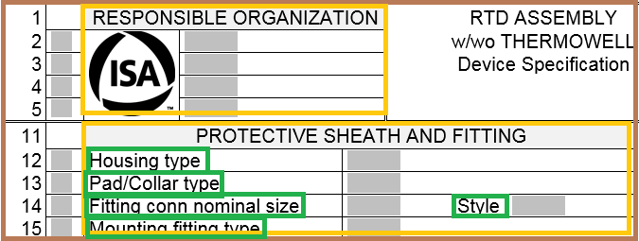
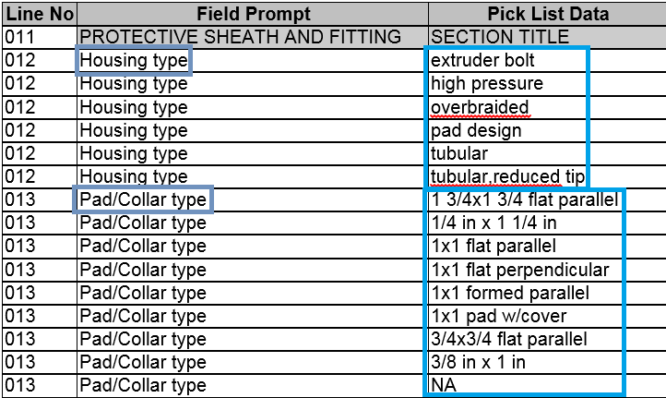
ISDD Example
Equipment Type
ISA 20T2221 Datasheet
Temperature Transmitter
Property Set Definition
Property Set Definition
20T2221 Device Specifications
20T1001 Operating Parameters
Property Group Definition
RESPONSIBLE ORGANIZATIONS
Property Group Definition
PROTECTIVE SHEATH AND FITTING
ISA 20T2221 Picklist
Property Definition
Property Type
Housing Type (Line 12)
Housing Type
Enumeration
Housing Type
Enumeration Items
Extruder bolt
High pressure
Property Definition
Property Type
Pad/Collar Type (Line 13)
Pad/Collar Type

Slide 55
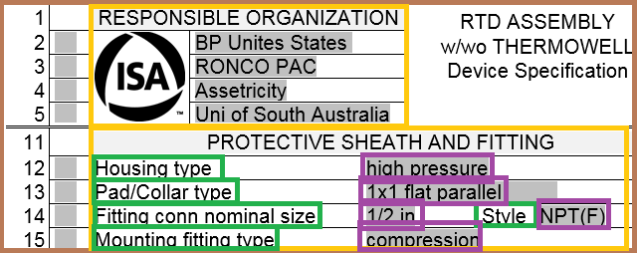
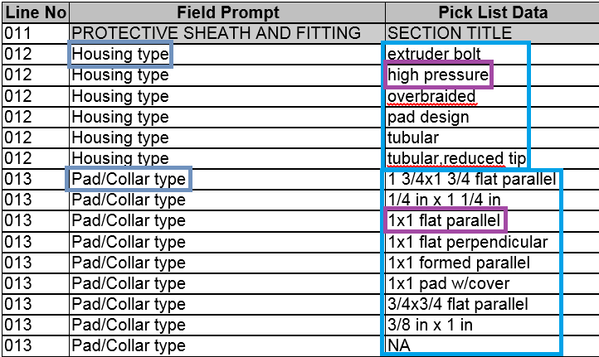
ISDD Example Instance
Equipment Type
ISA 20T2221 Datasheet
Temperature Transmitter
Property Set
Property Set
20T2221 Device Specifications
20T1001 Operating Parameters
Property Group
RESPONSIBLE ORGANIZATIONS
Property Group
PROTECTIVE SHEATH AND FITTING
ISA 20T2221 Picklist
Property
Attribute Type
Housing Type = high pressure
Housing Type
Property
Enumeration
Pad/Collar Type = 1x1 flat parallel
Housing Type
Property
Enumeration Items
Fitting conn nominal size = ½ in
Extruder bolt
Property
High pressure
Mounting fitting type = compression
….

Slide 56
How to connect to the OIIE?

Slide 57
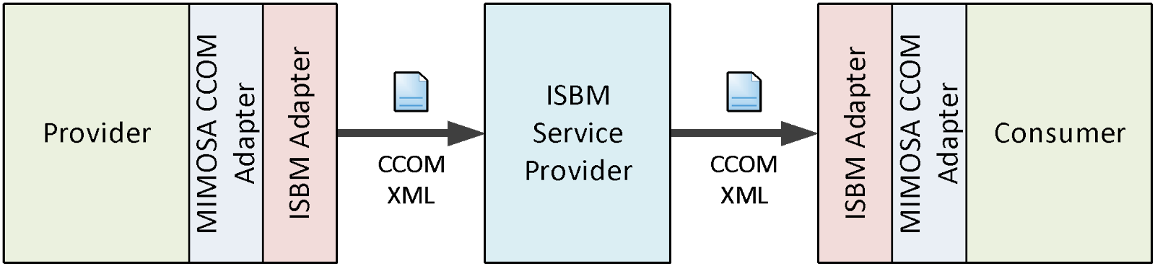
OIIE Adaptors
Each system/application participating in OIIE exchanges must have an adaptor
Can be considered in two parts:
  CCOM (or data) adaptor: converts internal data format to MIMOSA CCOM
  ISBM adaptor: communication with ISBM

Slide 58
Building an OIIE Adaptor (Simplified)
Obtain Web-service definitions
  SOAP/XML-based using WSDL
  REST/JSON-based using OpenAPI
Determine in which OIIE Use Case(s), Scenario(s), and Event(s) the application will participate
Identify the CCOM data elements and BODs must be supported
Map internal data to CCOM data elements
Identify the ISBM services to be implemented
Implement required services, mappings, and other considerations (e.g., error logging, auditing, persistence, UIs, etc.)

Slide 59
OGI Pilot CBM Demo

Slide 60


OIIE OGI Pilot Phase 3.1 Activities 1-4
(end 2018 – mid-2019)
Debutanizer Tower Condenser Unit P&ID
Worley Parsons: Hexagon (Proteus XML)
P&ID Logical Connection information
MIMOSA Structured Digital Asset Interoperability Registry
RFI/RFI Response (Greenfield)
RFI Response – Models
RFI – Functional requirements
Capital Project Asset Installation
Request for Model properties (ISDDs)
Asset instances selected from RFI Response (defined using ISDDs)
Installed on P&ID Tag locations (defined using ISDDs)
Procure
w/ OAGIS
EPC
OEM
Adding Detail to Prior Work
As-Designed O&M Takeoff using CCOM or Proteus
Use Cases ISDD Based Way of Specifying, Selecting and Buying Devices and Equipment
Use Case Adding As-Built Information Using OIIE Events

Slide 61



OIIE OGI Pilot Phase 3.1 Activities 5-8
(end 2018 – mid-2019)
Information Handover
From Capital Project to Operations and Maintenance
Condition Based Maintenance
Remove and Replace
Diagnostics
RFI/RFI Response
(Brownfield)
Information Remediation
Over ISBM (Information Service Bus Model)
Prognostics
Advisory Generation

Slide 62
Questions?

Slide 63
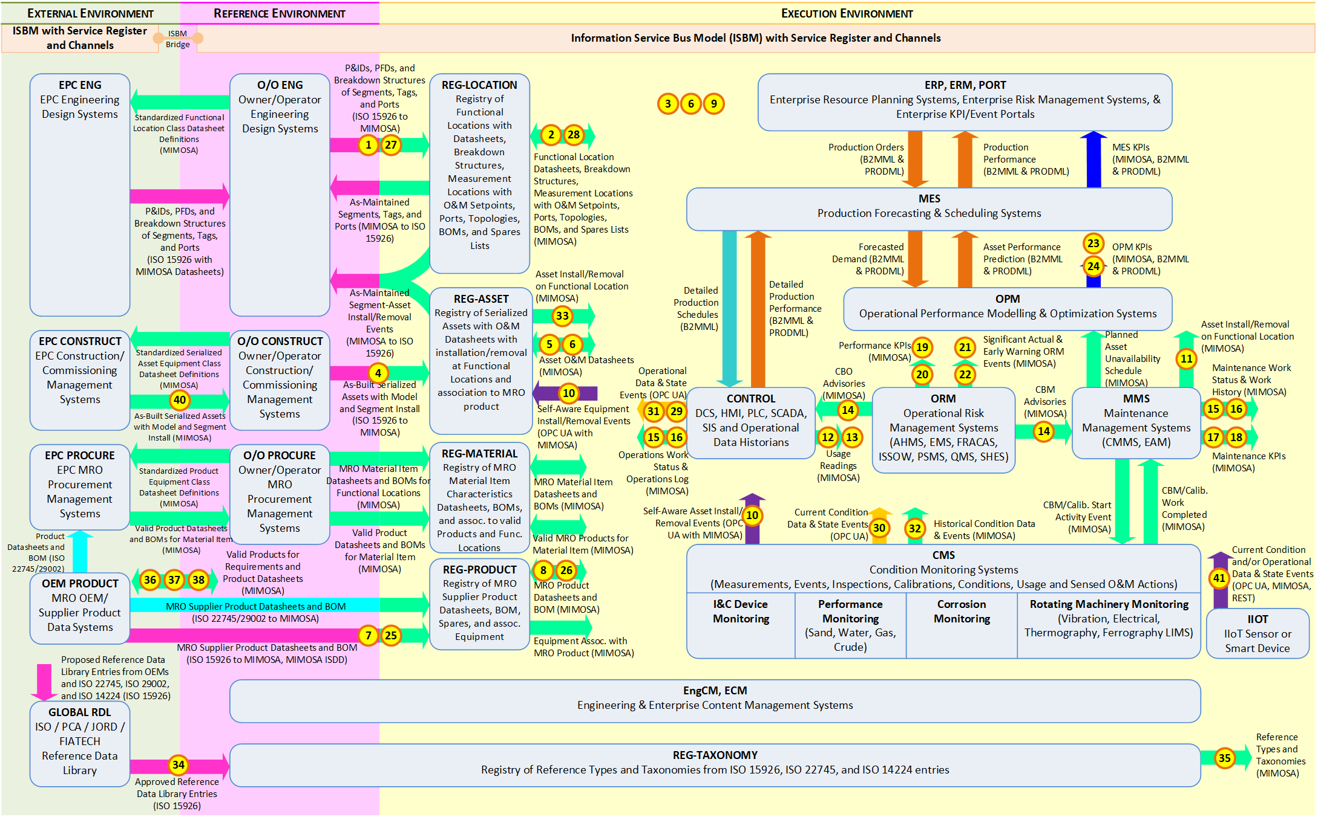
OIIE Systems and Scenarios Landscape
SDAIR

Slide 64
CBM According to ISO 13374
Machine condition assessment data processing & information flow blocks.
Sensor / Transducer / Manual Entry
External Systems,
Data Archiving, & Block Configuration
Technical Displays & Information Presentation
DATA ACQUISITION (DA)
DATA MANIPULATION (DM)
STATE DETECTION (SD)
HEALTH ASSESSMENT (HA)
PROGNOSTICS ASSESSMENT (PA)
ADVISORY GENERATION (AG)

Slide 65








Condition Based Maintenance and IIoT
Registry of digital asset data for contextualisation.
Owner/Operator
Device Manufacturer Supplying Remote Diagnostic/Prognostic/Advisory Support
Internally may have some or none of these systems.
Intra-Enterprise ISBM
May be same physical instance as the intra-enterprise ISBM
SDAIR
ERP
Operational Risk
Management System
Automation and Control
HSE and Operation Monitoring
Prognostic & Health Management
Inter-Enterprise
via ISBM
HSE and Operation Monitoring
Automated System Bus
Maintenance
Management System
Prognostic & Health Management
Device
Device
Sensor/ Transducer
IIoT
Device
Supports remote queries for measurement data and publishes advisories via ISBM.
Support for different protocols as required by industry.
IIoT
Device
IIoT
Device
Support for different protocols as required by industry.
Notes:
Architectural diagram
Sensors -> Measurements -> Diagnostics/Prognostics (Analysis) -> Advisory (Operational Risk Management System) -> Maintenance Management System
Diagnostics/Prognostics may come from same “chip”
Local diagnostic/advisory (Control System and/or ISBM)
Inter-enterprise diagnostic/measurement info: query-based over ISBM
Show both OPC UA and CCOM REST/JSON API

Slide 66
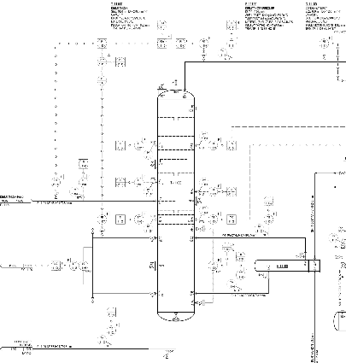
CCOM Contextualisation—Maintained by SDAIR
Asset
Debutanizer
Serial # DZR-3246
Each object uniquely identified by a UUID. Also refer back to the system of record.
Asset
Tower
Serial # T-456
Asset
Pipe Section
Asset
Condenser
Serial # CF332
Asset
Temp. Sensor
Serial # TS-999
Transducer
Model
Debutanizer
DZR 5000
Measurement Location
Temp. Loc. 1
Measurement
Recorded at:
2018-06-01:01:00
Measurement
Recorded at:
2018-06-01:01:00
Measurement
Recorded at:
2018-06-01:01:00
AssetSegmentEvent
Install
1 Jan 2018
AssetSegmentEvent
Install
1 Jan 2018
AssetSegmentEvent
Install
1 Jan 2018
AssetSegmentEvent
Install
1 Jan 2018
Measurement
10ºC at:
2018-06-01:01:00
Supports both Asset-
and Segment-based
MeasurementLocations
AttributeSet
Custom Measurement Data
Segment
Debutanizer Tower T100
Segment
Debutanizer Feed
Segment
Condenser C200
Segment
Temperature Sensor TS-1
Breakdown Structure
Primary
Segment
Temperature Sensor TS-2
Measurement Location
Temp. Loc. 2
Measurement
Recorded at:
2018-06-01:01:00
Measurement
Recorded at:
2018-06-01:01:00
Measurement
Recorded at:
2018-06-01:01:00
Measurement
4ºC at:
2018-06-01:01:00

Slide 67
CCOM Contextualisation—Configuration Change
Remove/Replace
Asset
Debutanizer
Serial # DZR-3246
Asset
Tower
Serial # T-456
Asset
Pipe Section
Asset
Condenser
Serial # CF332
Asset
Temp. Sensor
Serial # TS-999
Transducer
Asset
Pipe Section
Model
Debutanizer
DZR 5000
Measurement Location
Temp. Loc. 1
Measurement
Recorded at:
2018-06-01:01:00
Measurement
Recorded at:
2018-06-01:01:00
Measurement
Recorded at:
2018-06-01:01:00
AssetSegmentEvent
Install
1 Jan 2018
AssetSegmentEvent
Install
1 Jan 2018
AssetSegmentEvent
Install
1 Jan 2018
AssetSegmentEvent
Install
1 Jan 2018
Measurement
10ºC at:
2018-06-01:01:00
AssetSegmentEvent
Remove
2 Jan 2018
AssetSegmentEvent
Install
3 Jan 2018
Supports both Asset-
and Segment-based
MeasurementLocations
AttributeSet
Custom Measurement Data
Segment
Debutanizer Tower T100
Segment
Debutanizer Feed
Segment
Condenser C200
Segment
Temperature Sensor TS-1
Breakdown Structure
Primary
Segment
Temperature Sensor TS-2
Measurement Location
Temp. Loc. 2
Measurement
Recorded at:
2018-06-01:01:00
Measurement
Recorded at:
2018-06-01:01:00
Measurement
Recorded at:
2018-06-01:01:00
Measurement
4ºC at:
2018-06-01:01:00

Slide 68
Example—Mesh Networks
Model
Debutanizer
DZR 5000
from
Segment
Feed Outlet
parent
Segment
Debutanizer Feed
Segment Connection
Segment
T100 Inlet
to
parent
Segment
Debutanizer Tower T100
from
Segment
T100 Outlet A
parent
Segment Mesh
DZR Connections
Segment Connection
Segment
Debutanizer Overhead Inlet
parent
Segment
Overhead Piping Segment
.
.
.
to
And similar at
the Asset level
from
Segment
… Outlet
parent
Segment
…
Segment Connection
Segment
… Inlet
parent
Segment
…
to

